Slide 1
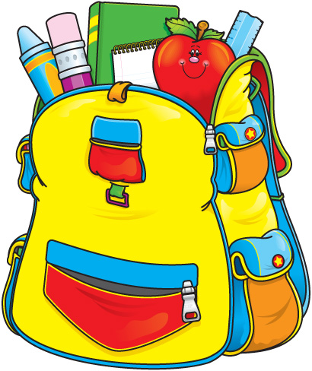
SCHOOL. THE THINGS YOU CAN USE IN THE LESSON.

Slide 2
[Ə] [e] [U] teacher pencil book computer desk textbook sharpener lesson workbook answer question look

Slide 3
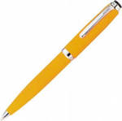
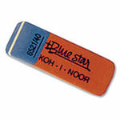
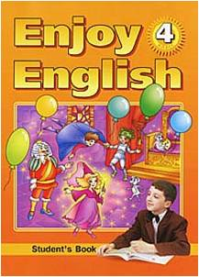
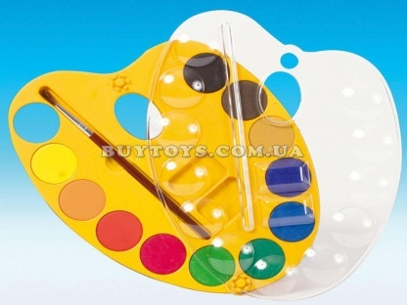
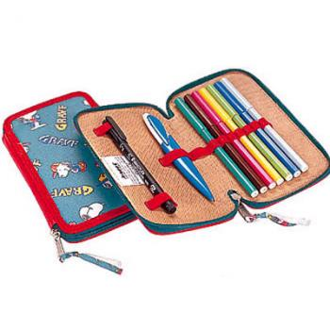
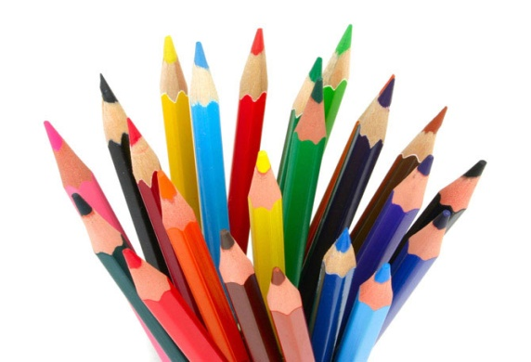
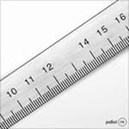
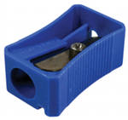
Things for School

Slide 4
I have got (a)…
in my schoolbag.

Slide 5
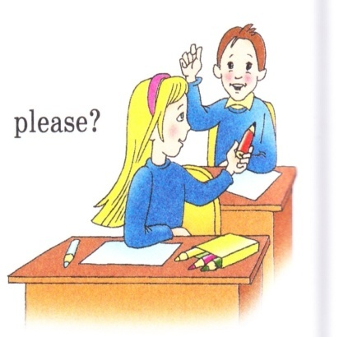
COMPLETE THE DIALOGUE:
P1: Hello, _____!
P2: Hello, ____! How are you?
P1: I’ m fine, thank you.
P1: ____, what do you usually take to school?
P2: I take _______ to school. But what’s the matter?
P1: I’ve left my ______ at home. Could you give me your _____ please?
P2: Oh, yes. Here you are.
P1: Thank you!
P2: You’re welcome.

Slide 6
Mag’s letter. Read the letter, fill in the gaps and answer the questions.
break, bag, answer, textbooks, write, pencil box, learn, lessons, workbooks, read.
Hello Friends,
My name is Mag. I am from England. I am a pupil of the 4th form. I’d like to tell you about my school. English children go to school at the age of five. They have holidays three times a year. Some schools in England are only for boys or for girls. My school is nice and big. There are many classrooms in my school. I put my _______, ________and a ______ into my ______ and then I go to school. We usually have four ______ every day. At the lessons we ____ new words in our workbooks, ____ the questions and ____ English texts in our textbooks. Sometimes we ____ poems by heart. I like to answer the teacher’s questions. During the ____ I usually talk to my friends and have lunch. I have got a lot of friends there. We have a good time at school.
What form are you in?
Is your school nice and big?
How many lessons do you usually have every day?
What school things do you take to school?
What do you usually do during the lessons?
Love, Mag.

Slide 7
Mag’s letter. Read the letter, fill in the gaps and answer the questions. Break, bag, answer, textbooks, write, a pencil box, learn, lessons, workbooks, read.
Hello Friends,
My name is Mag. I am from England. I am a pupil of the 4th form. I’d like to tell you about my school. English children go to school at the age of five. They have holidays three times a year. Some schools in England are only for boys or for girls. My school is nice and big. There are many classrooms in my school. I put my textbooks, workbooks and a pencil box into my bag and then I go to school. We usually have four lessons every day. At the lessons we write new words in our workbooks, answer the questions and read English texts in our textbooks. Sometimes we learn poems by heart. I like to answer the teacher’s questions. During the break I usually talk to my friends and have lunch. I have got a lot of friends there. We have a good time at school.
What form are you in?
Is your school nice and big?
How many lessons do you usually have every day?
What school things do you take to school?
What do you usually do during the lessons?
Love, Mag.

Slide 8
A guessing – game.
Is it big or small?
What colour is it?
Is it in the bag or on the desk?
Can we …. using it?
Is it…?
What is it?

Slide 9
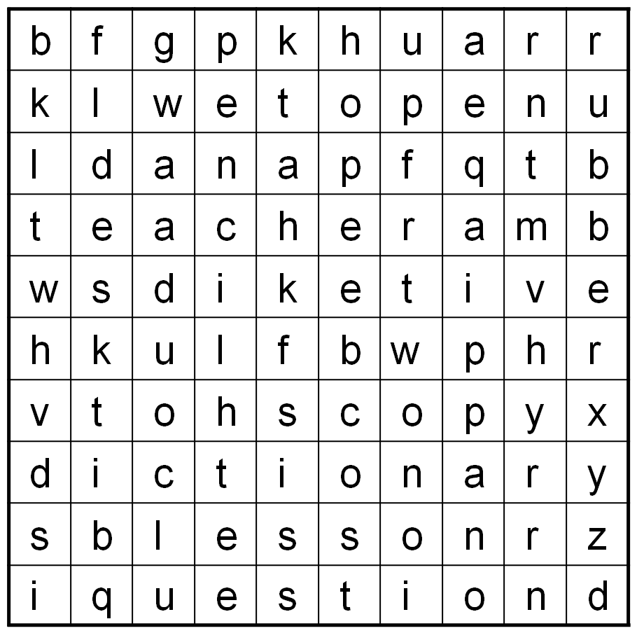
Find 10 words
blackboard
copy
teacher
desk
question
dictionary
pencil
pen
rubber
lesson

Slide 10
Let’s check
b | f | g | p | k | h | u | a | r | r
k | l | w | e | t | o | p | e | n | u
l | d | a | n | a | p | f | q | t | b
t | e | a | c | h | e | r | a | m | b
w | s | d | i | k | e | t | i | v | e
h | k | u | l | f | b | w | p | h | r
v | t | o | h | s | c | o | p | y | x
d | i | c | t | i | o | n | a | r | y
s | b | l | e | s | s | o | n | r | z
i | q | u | e | s | t | i | o | n | d
blackboard
copy
teacher
desk
question
dictionary
pencil
pen
rubber
lesson

Slide 11
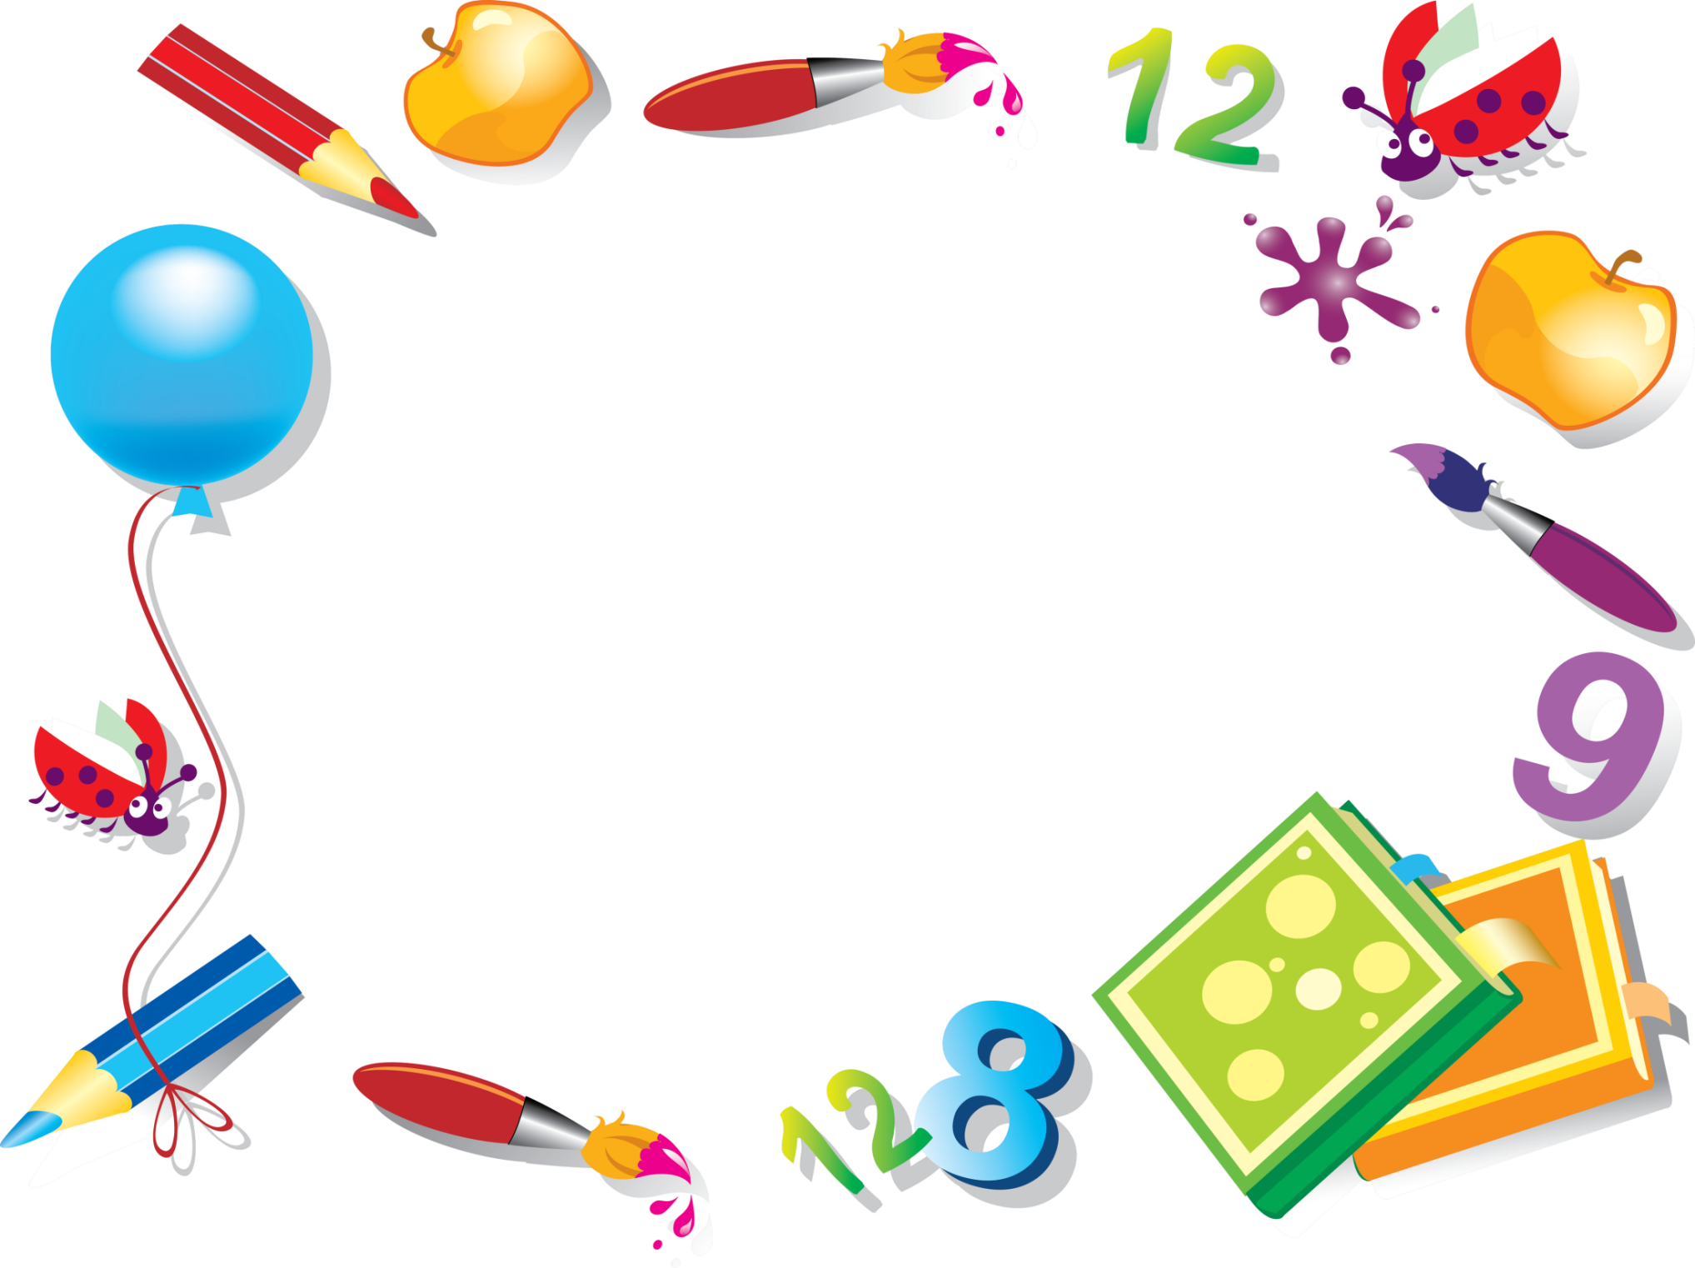
You can use
(a) ……
in the lesson.

Slide 12
Home task:
W.B. p.57, ex.6-8

