Slide 1
Russian University of Transport Law Institute Сustoms Declaration of the Russian Federation
2nd Year Students, BONDAREVA RAISA
Programme: International SOROKINA VIKTORIA
Customs Cooperation
Research Advisor: Konysheva MariNa PhD, Associate Professor Vladimirovna

Slide 2
Work structure
1. The concept of a customs declaration;
2. Types of customs declaration;
2.1 declaration of goods;
2.2 transit declaration;
2.3 passenger customs declaration;
2.4 vehicle declaration.

Slide 3
Сustoms declaration
This is a document that contains information about goods being moved across the state border. This document is drawn up in accordance with the rules established by a particular state.

Slide 4
Types of customs declaration
In accordance with Art. 180 TC TC during the customs declaration of goods the following types of customs declaration are applied:
1) declaration of goods;
2) transit declaration;
3) passenger customs declaration;
4) vehicle declaration.

Slide 5
Declaration of goods
A goods declaration is a document drawn up for goods when moving them across the customs border. It contains information about the cargo and its customs value, transport, delivery, delivery conditions, sender and recipient, as well as other information in accordance with Art. 181 TC TC.

Slide 6
Transit declaration
In accordance with Art. 182 TC TC when placing goods under the customs procedure of customs transit, the customs authority of departure is presented with a transit declaration. As a transit declaration, transport (transportation), commercial and (or) other documents, including those specified by international treaties, containing various information may be presented.

Slide 7
Passenger customs declaration
In accordance with paragraph 3 of Art. 355 TC TC, the customs declaration of goods for personal use is carried out in writing using the passenger customs declaration, which is intended to declare in writing information about goods transported across the customs border of the Russian Federation by individuals (any movable property, including currency, currency values) and the purposes of their movement, as well as for use as a permit document of the customs authority, reflecting the results of customs clearance.

Slide 8
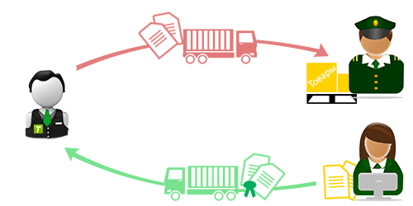
Vehicle declaration
In accordance with Art. 350 TC TC Customs declaration of vehicles of international transport is carried out when temporarily importing into the customs territory of the customs union of vehicles of international transport and exporting such temporarily imported vehicles from such territory, as well as when temporarily exporting from the customs territory of the customs union of vehicles of international transport and import of such temporarily exported vehicles of international transport to such territory by filing by the carrier with customs about The customs declaration of the vehicle.

Slide 9
Thus, the Federal Customs Service checks the accuracy of the information and filling out the declaration, compares it with other documents submitted for customs clearance.
The preparation of a customs declaration requires extensive specialized knowledge and some practical experience.
Therefore, it is necessary to contact specialized organizations whose employees will help in the preparation of the relevant customs declaration.

Slide 10
Thanks for attention!!!

Slide 11
Russian University of Transport Law Institute Сustoms Declaration of the Russian Federation
2nd Year Student, BONDAREVA RAISA
Programme: International
Customs Cooperation
Research Advisor: Konysheva MariNa PhD, Associate Professor Vladimirovna

