Slide 1
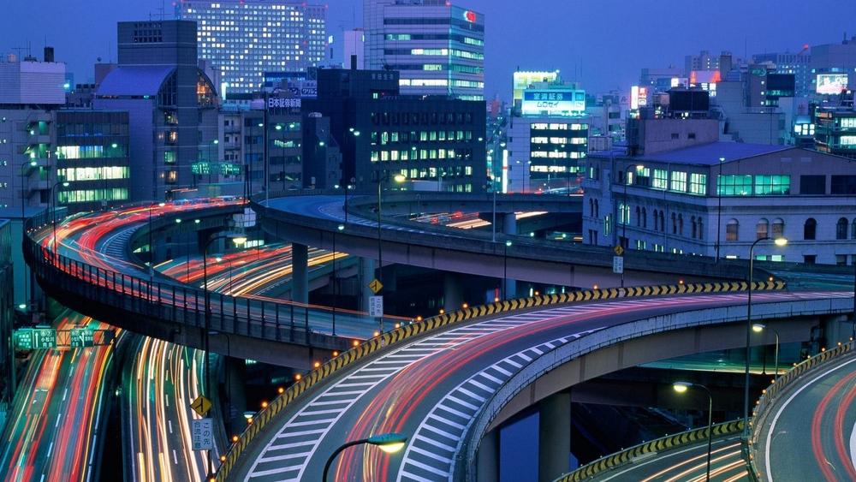
Russian University of Transport (MIIT)
Law Institute
TRANSPORT LEGISLATION
IN JAPAN
Kotzuba Veronika
ЮЮУ-111
Research Advisor: Konysheva Marina V.
Moscow, 2020

Slide 2
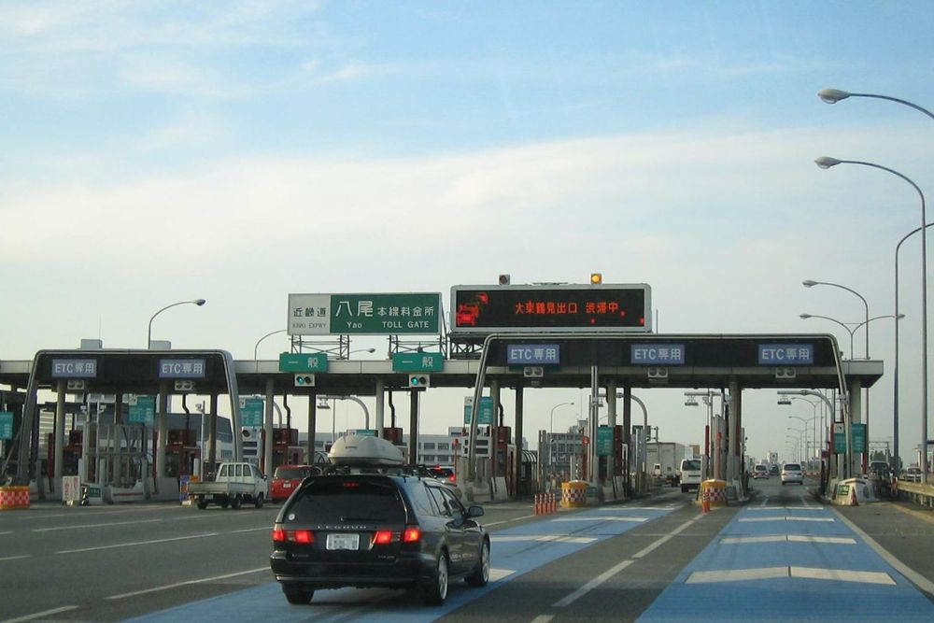
Contents
1. Weekly Rush Hour 2. Number of Automobile Accidents and Traffic Fatalities in Japan 3. Traffic Fatalities Among Senior and Other Citizens in Japan 4.Congection Level 5. Weekly Traffic Congestions by Time of Day 6. Time Lost in Rush Hour – Per Day

Slide 9
THANKS FOR WATCHING

Slide 10
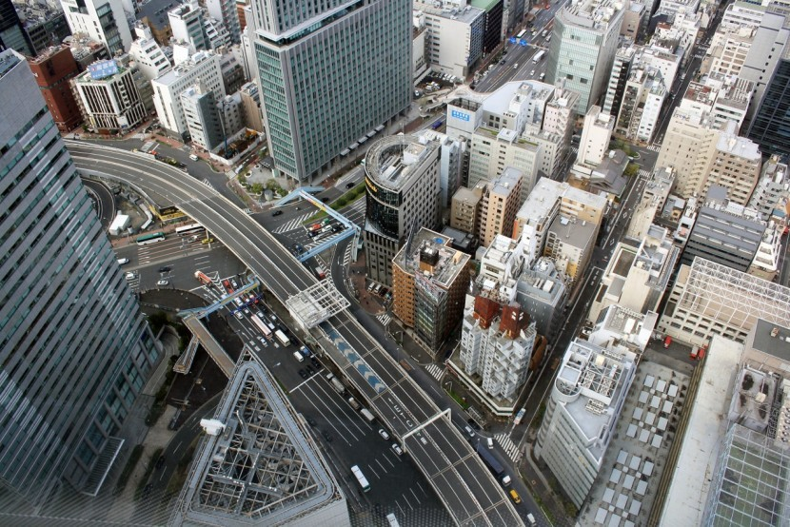
Russian University of Transport (MIIT)
Law Institute
TRANSPORT LEGISLATION
IN JAPAN

