Slide 1
Alternative Therapies
Form 9
Разработано учителем МБОУ Гимназия №44 г. Курска, Амелиной С.Ю.

Slide 2
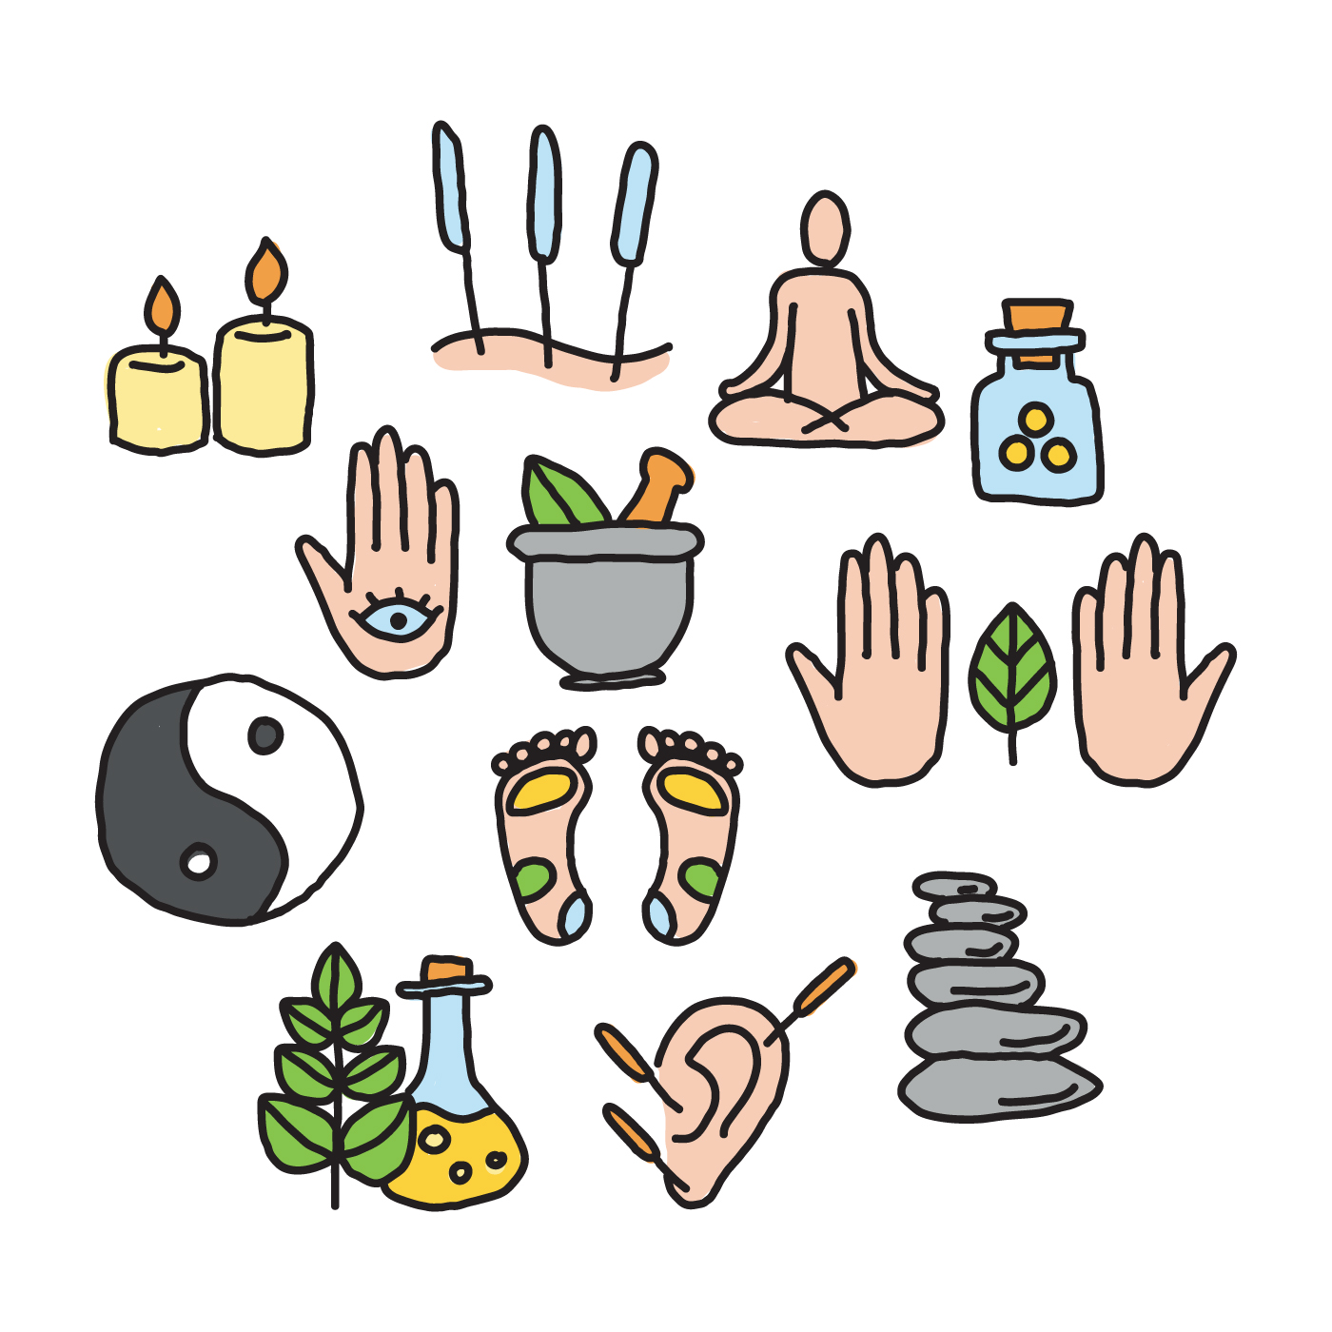
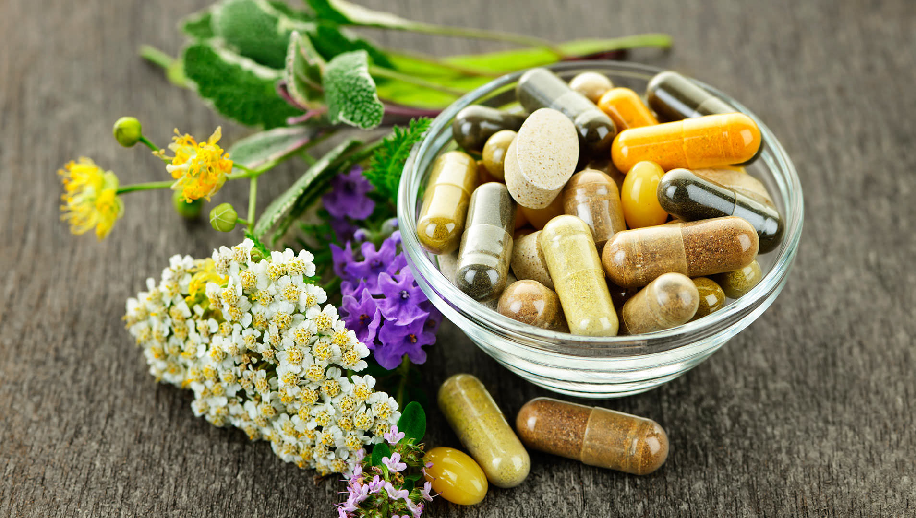
Can you guess the topic of today’s lesson?

Slide 3
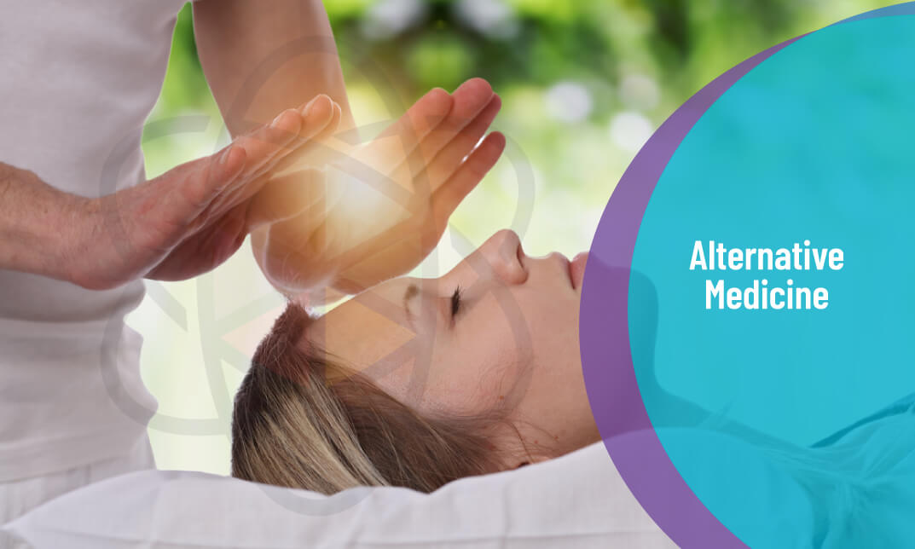

Slide 4
Find which of these words are mentioned in ex,1 p,48
θerəˈpjuːtɪk
ˈɑːtɪst
hɪpnəˈθerəpɪ
ɑːˈθraɪtɪs
ɪndɪˈʤesʧən
kənˈʤɛsʧən
ˌɒstɪəʊpɔːˈrəʊsɪs
ˈækjʊˌpʌŋ(k)ʧə
kənˈʤʌŋkʃən
ˌpʌŋktjʊˈeɪʃən
ˈkɒnʃəns

Slide 5
Fill in the gaps
David asked his yoga instructor for advice on _______________.
He had been suffering from _______________ for several years, but he never consulted a nutritionist. Unfortunately, this led to more serious symptoms and even _________ appeared in his stomach.
After his _______________ he got regular headaches. Obviously, that fall caused brain problems and a constant ___________.
She got those ____________ on her hand when she poured boiling water over herself in the kitchen.

Slide 6
Complete the definitions.
Arthritis is a serious condition ...
Acupuncture is a treatment for pain or illness …
Reflexology is a treatment ...
Osteoporosis is a disease ...
Homeopathy is a system of treatment ...
Panic attack is a sudden period of anxiety ...
in which your feet are pressed in a special way to improve blood circulation.
in which thin needles are positioned into the body.
in which a person's joints become painful, swollen, and stiff.
in which your heart beats fast and you have trouble breathing.
which makes the bones weak and fragile.
which is based on mantras and relaxation.
which is based on natural substances.
which makes you feel regular stomachaches.

Slide 7
Find the key word.
 |  |  | 1
 |  | 2
 | 3
 |  |  |  |  | 4
 |  | 5
6
7
A relaxing therapy in which the doctor binds and rubs your legs, feet, arms and hands.
A relaxing practice in which you keep your mind calm and clear.
A bubble which appears on the skin after a burn.
Blood coming from your nose.
A disease of fragile bones.
Regular feeling of sadness.
A brain problem after a severe fall or blow.

Slide 8
 |  |  | r | e | F | l | e | x | o | l | o | g | y
 |  | m | e | d | I | t | a | t | i | o | n
 | b | l | i | s | T | e | r | s
 |  |  |  |  | N | o | s | e | b | l | e | e | d
 |  | o | s | t | E | o | p | o | r | o | s | i | s
d | e | p | r | e | S | s | i | o | n
c | o | n | c | u | S | s | i | o | n

Slide 9
Study the words and use them in your monologue.
https://quizlet.com/_94syax?x=1qqt&i=28mpqy
You are going to give a talk about alternative therapies. Mention the following.
What types of alternative therapies do you know?
What is hypnosis?
Why do many people try hypnosis to feel better?
What is your attitude to hypnosis and other alternative therapies?

Slide 10
Homework – Workbook ex.1 p.32; think of three advantages and disadvantages of using alternative therapy.
Now have a break and be healthy!

Slide 11
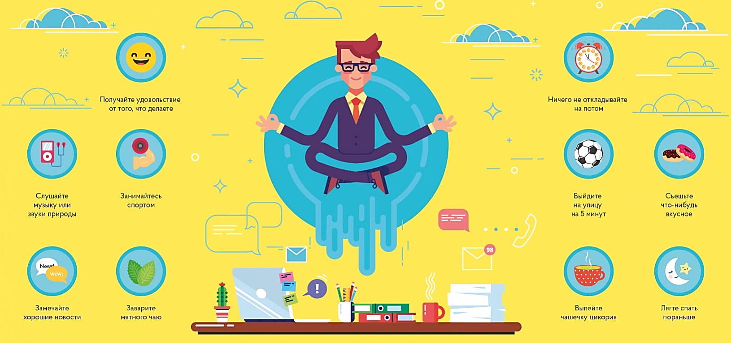
Enjoy the things you do
Don’t put off things
Listen to music or the sounds of nature
Do exercises
Spend 5 min outdoors
Eat sth tasty
Pay attention to good news
Drink mint tea
Have a hot chocolate
Go to bed earlier

Slide 12
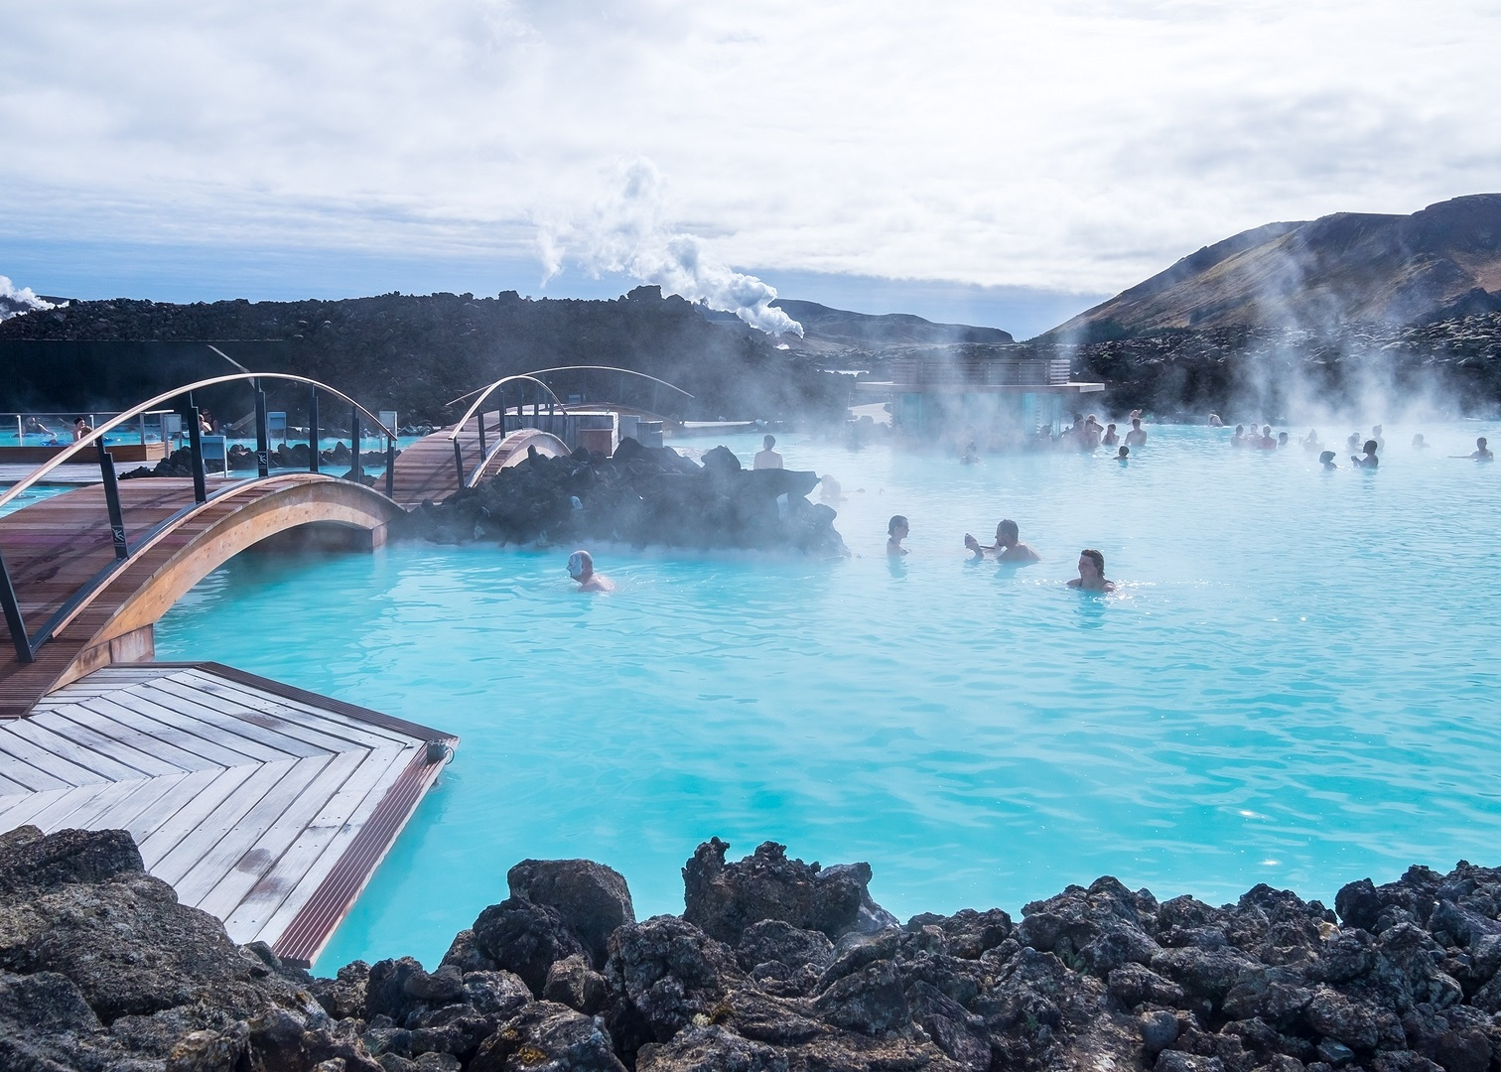
Natural Spots for Relaxation

Slide 13
Match the words and their transcription
seismic
roar
tread
geothermal
cleanse
warrior
wound
acid
diameter
ache
[ˈsaɪz.mɪk]
[ˈseɪs.mɪk]
[rɔː]
[rɔːar]
[tri:d]
[tred]
[ˌgiː.əˈθɜː.məl]
[ˌdʒiː.əʊˈθɜː.məl]
[klenz]
[klins]
[ˈwar.i.ər]
[ˈwɒr.i.ər]
[wuːnd]
[waʊnd]
[ˈæsɪd]
[ˈeisɪd]
[dɪəˈmɪ:tər]
[daɪˈæm.ɪ.tər]
[eɪk]
[eɪtS]

Slide 14
Match the words and their synonyms.
an eruption
seismic activity
to steam
to roar
to cleanse
acid
beauty products
a warrior
to treat wounds
to heal injuries
an earthquake
to purify
to produce gas
a fighter
to make noise
a sudden volcanic activity
a dangerous chemical
skin care goods

Slide 15
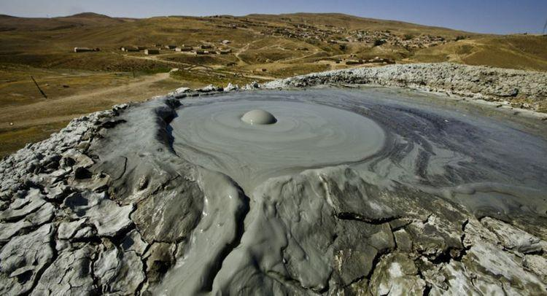
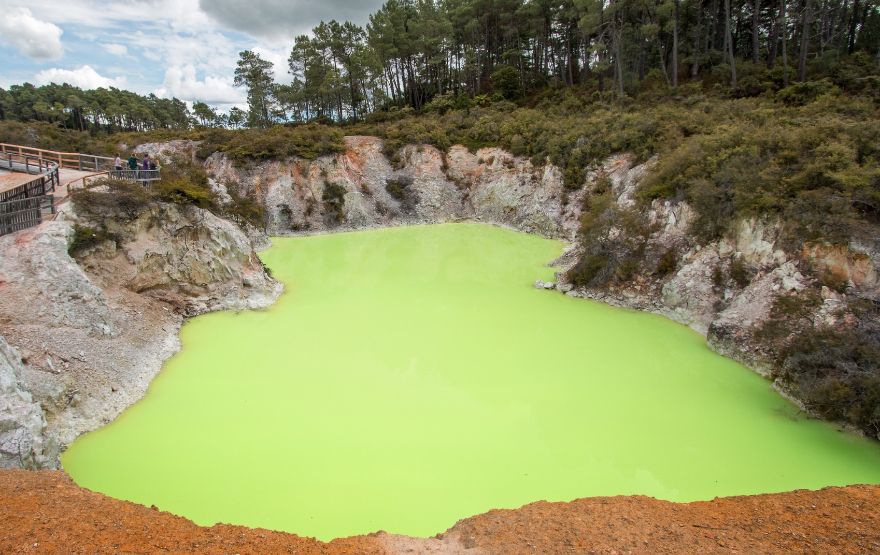
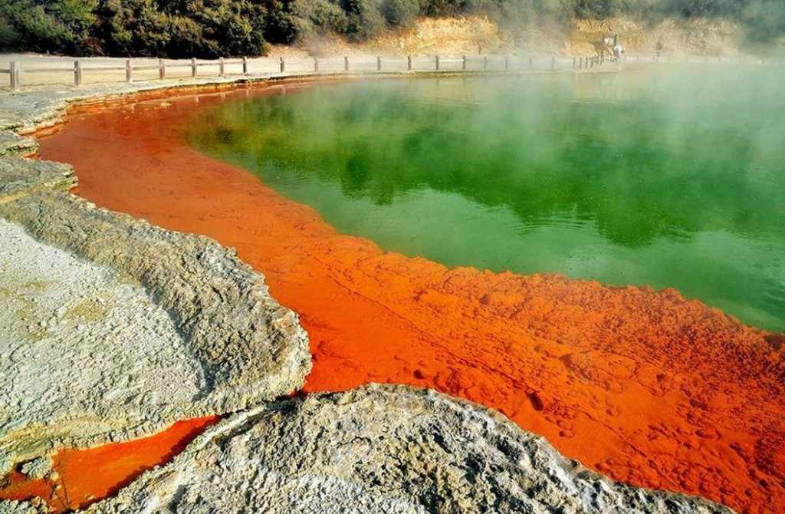
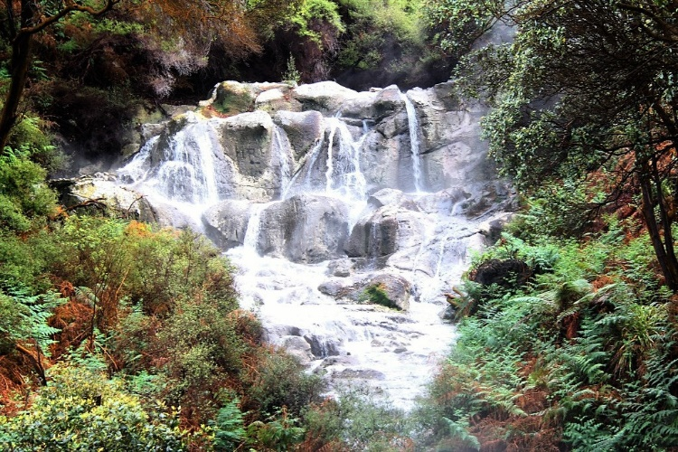
Which spots do the pictures show?

