Slide 1
Урок английского языка
3 класс. Spotlight 3.
Present Continuous
Ветрова Олеся Витальевна.

Slide 2
Let`s repeat new words
Повторим новые слова

Slide 3
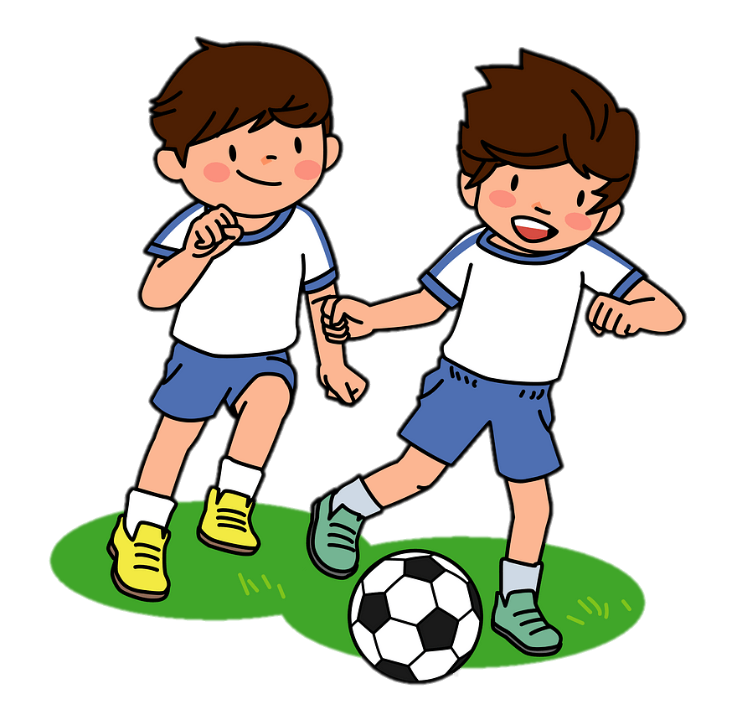
playing soccer

Slide 4
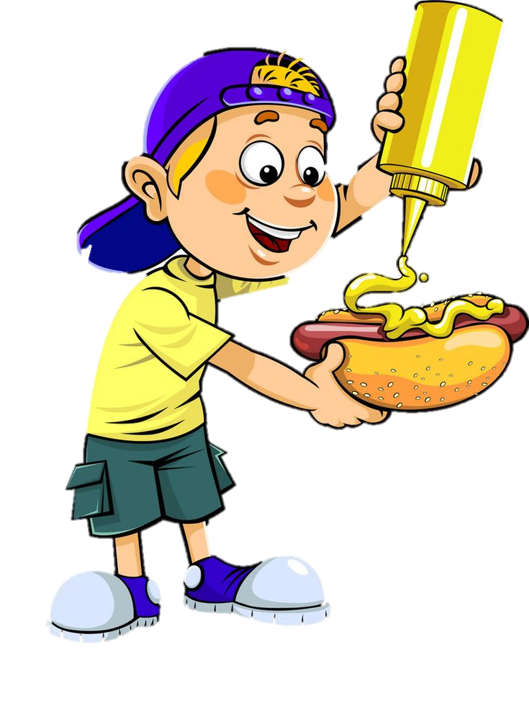
eating a hot dog

Slide 5
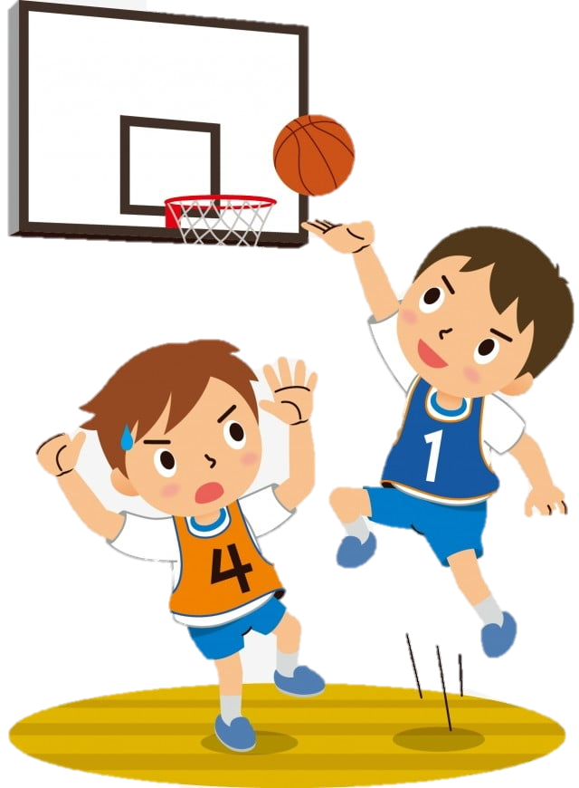
playing basketball

Slide 6
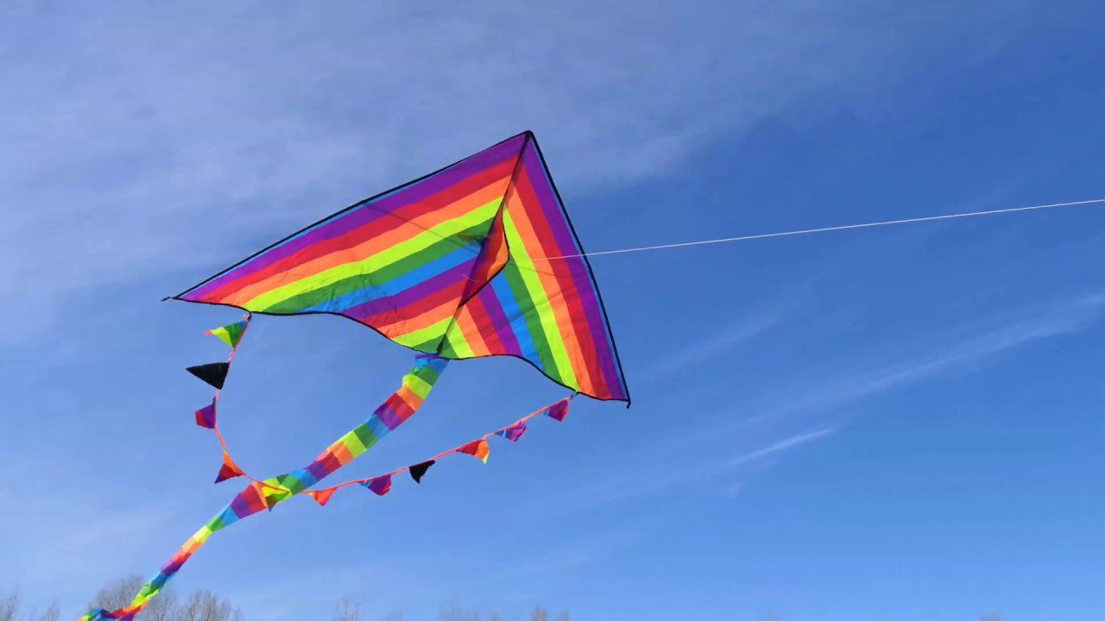
flying a kite

Slide 7
riding a bike

Slide 8
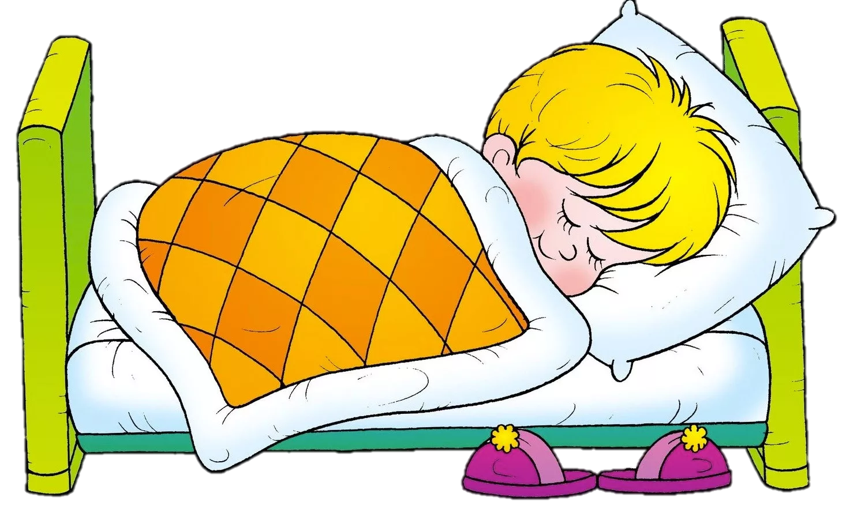
sleeping

Slide 9
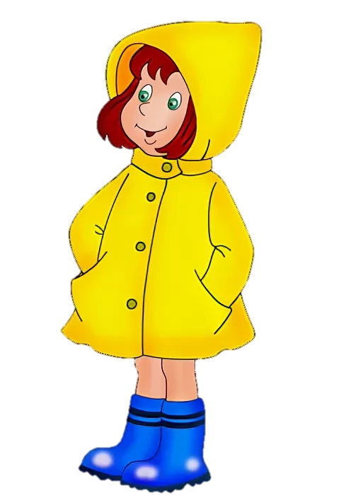
wearing a mac

Slide 10
Choose the correct answer
Выбери правильные ответ

Slide 11
1
2
3
playing soccer

Slide 12
1
2
3
riding a bike

Slide 13
1
2
3
wearing a mac

Slide 14
wearing a mac
eating a hot dog
playing soccer

Slide 15
riding a bike
wearing a mac
sleeping

Slide 16
playing soccer
drinking Coke
playing basketball

Slide 17
playing soccer

Slide 18
flying a kite

Slide 19
1. Послушай запись и соедини

Slide 20
1
What are they doing? Listen and match
H. sleeping
A. playing soccer
1. Neil and Max
2. Debbie
3. Lee
4. Pat and Ellie
5. Bill
6. Ken
G. drinking Coke
B. eating a hot dog
C. playing basketball
F. wearing a mac
D. flying a kite
E. riding a bike

Slide 21
2. Заполни пропусти в таблице и выполни задание

Slide 22
2
Present Continuous
Настоящее продолженное время
+ | I | _____ | working
 | He/ She/ It | is | working
 | We/ You/ They | are | working
- | I | am not | working
 | He/ She/ It | is not / isn`t | working
 | We/ You/ They | ________ /_______ | working
? | Am | I | working?
 | _____ | he/ she/ it | working?
 | Are | we/ you/ they | working?
am
are
aren`t
Is

Slide 23
2
Read and complete
Mum: Hello, dear! Is everything OK? What 1) are the children doing (the children/do)?
Dad: Well, Judy 2)__________________(play) with some toys and Ben 3) __________________(jump) up and down on the bed.
Mum: And the baby?
Dad: The baby 4)_______________(eat).
is playing
is jumping
is eating

Slide 24
Our lesson is over. Thank you! Good byе!

