Slide 1
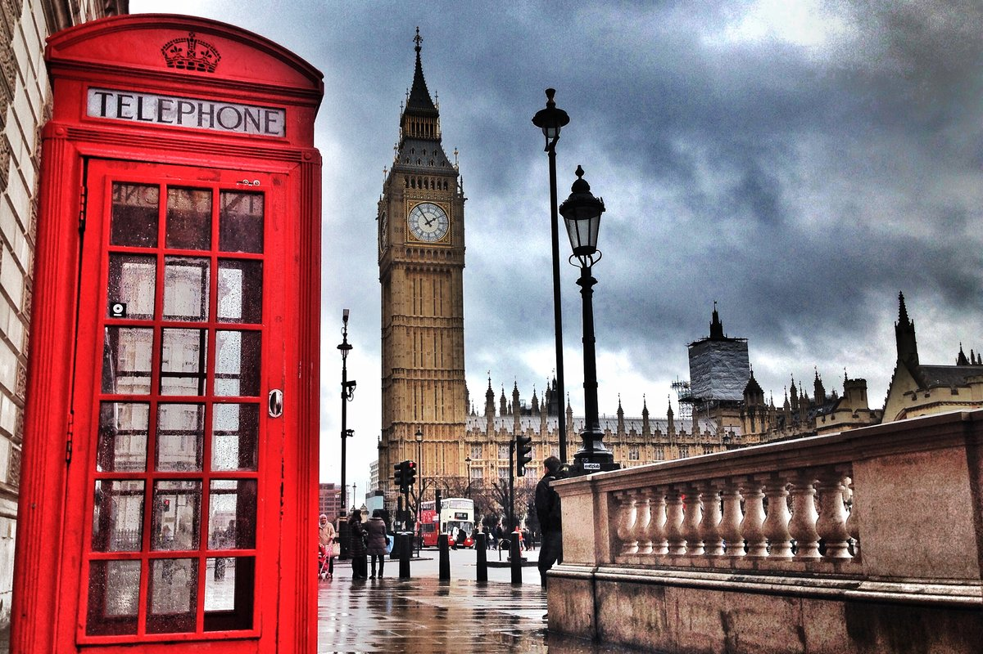
Great Britain

Slide 2
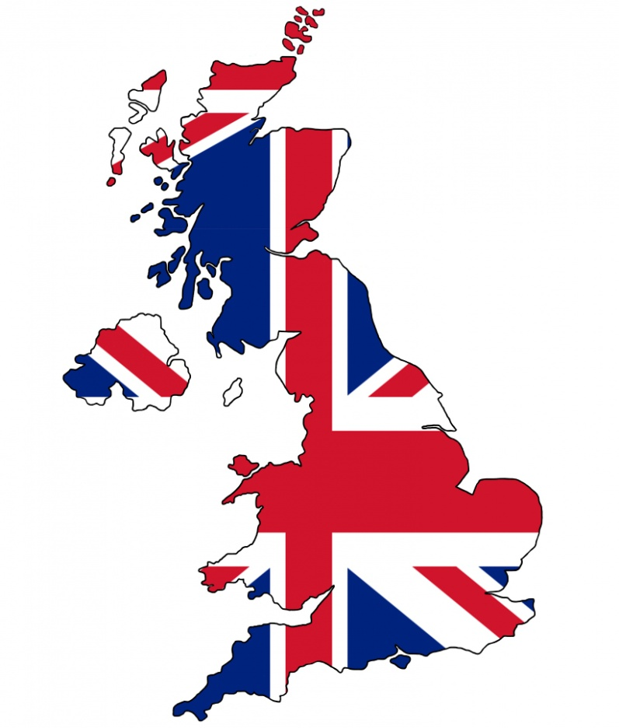
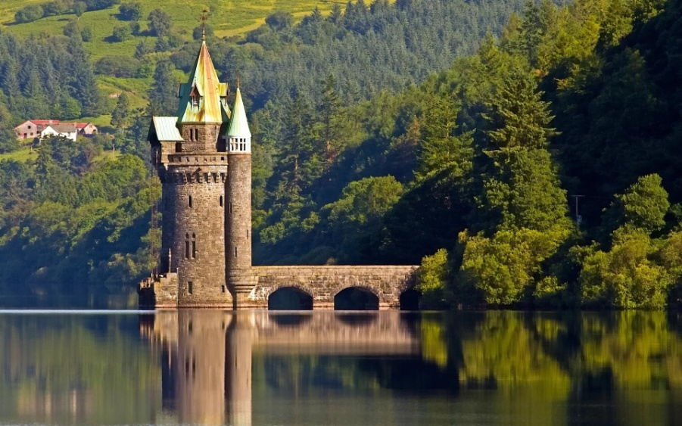
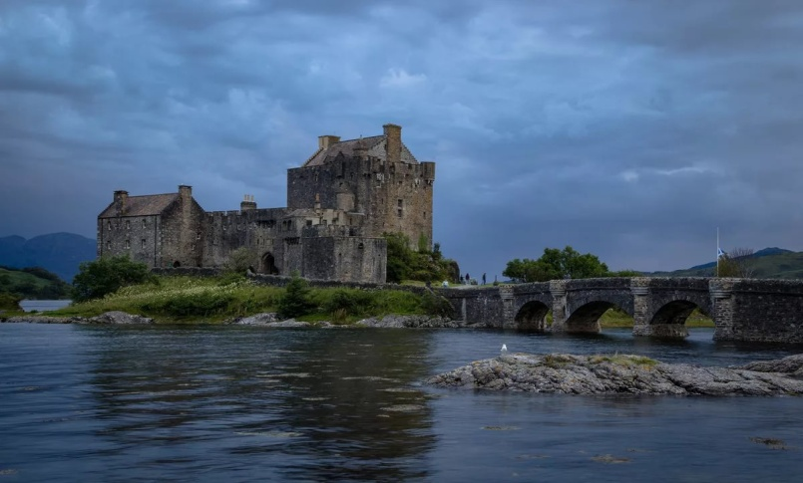
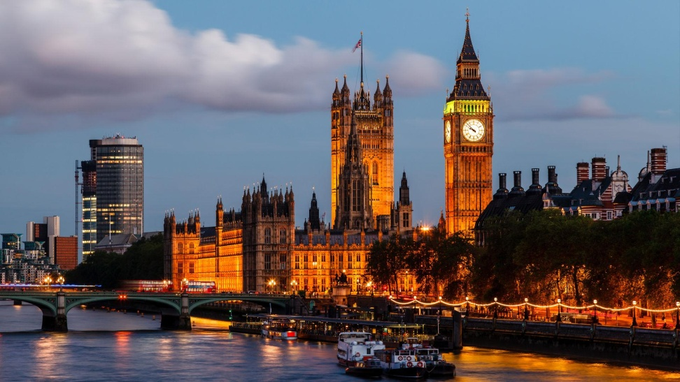
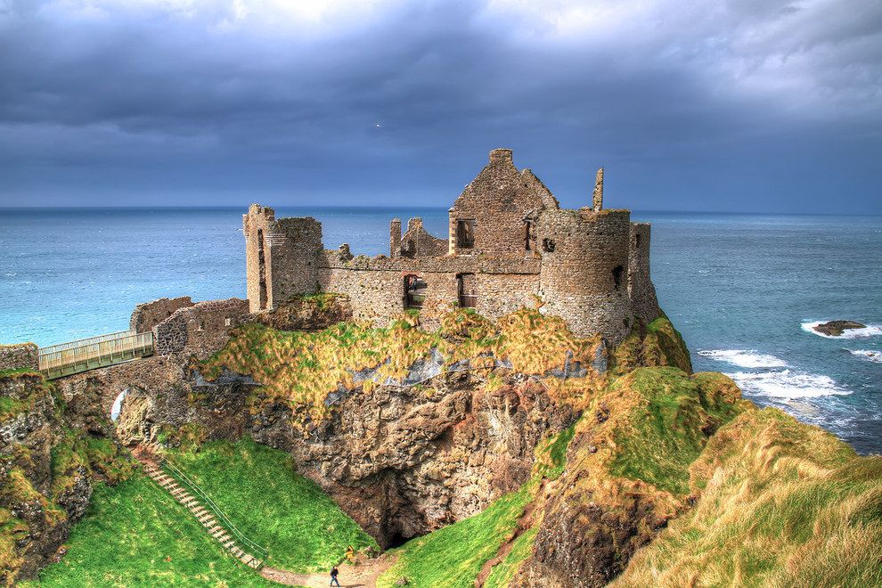
Great Britain

Slide 3
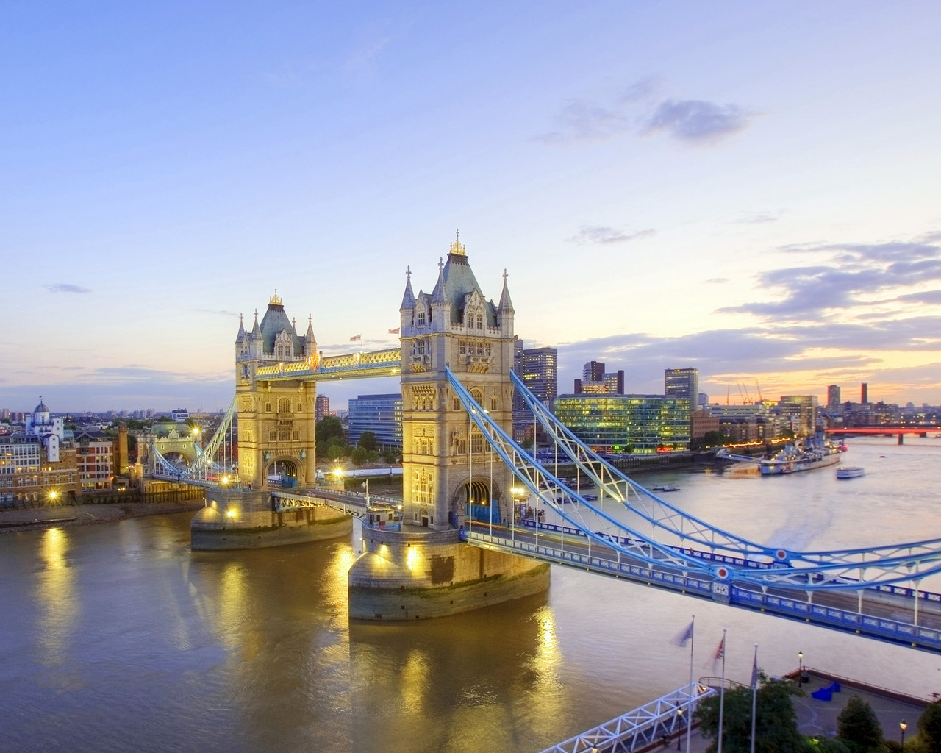
Great Britain
Ireland
Northern Ireland
England
Scotland
Wales
The British Isles
The United Kingdom
The UK
The United Kingdom of Great Britain and Northern Ireland
The Thames

Slide 4
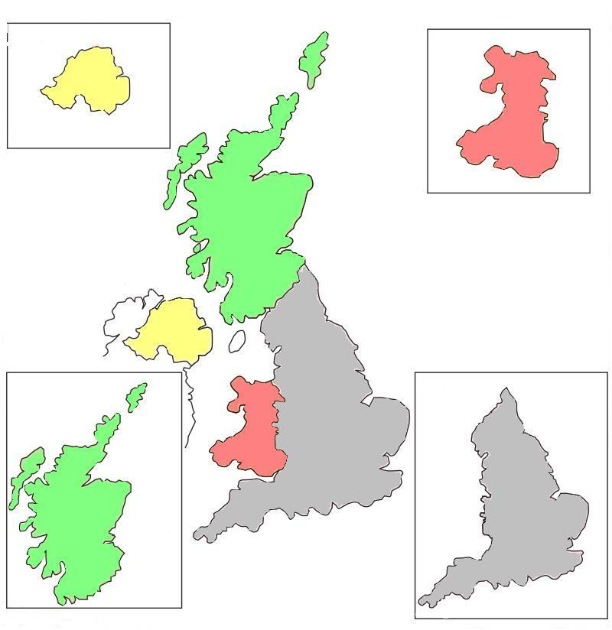
Ireland
Ireland
Wales
scotland
ENGLand

Slide 7
When Yura (be)____________in London, he visited a lot of wonderful places. He (see) _______________the Tower of London and Buckingham Palace, he (go)_______________to Hyde Park and London Zoo. Together with John Barker they (walk) ___________in the streets of London. Yura (buy)______________some things in Oxford Street and (take)_____________ a lot of pictures in Trafalgar Square. The boys (spend)_______________two hours in the National Gallery and then (have)_____________a trip around London on a red double-decker bus. Yura (love) _______________ the capital of Great Britain and (decide) ________________to come to London again some day.

Slide 8
When Yura was in London, he visited a lot of wonderful places. He saw the Tower of London and Buckingham Palace, he went to Hyde Park and London Zoo. Together with John Barker they walk in the streets of London. Yura bought some things in Oxford Street and took a lot of pictures in Trafalgar Square. The boys spent two hours in the National Gallery and then had a trip around London on a red double-decker bus. Yura loved the capital of Great Britain and decided to come to London again some day.

Slide 9
Up, down, up, down.
Which is the way to London Town?
Where? Where?
Up in the air,
Close your eyes
And you are there!

Slide 10
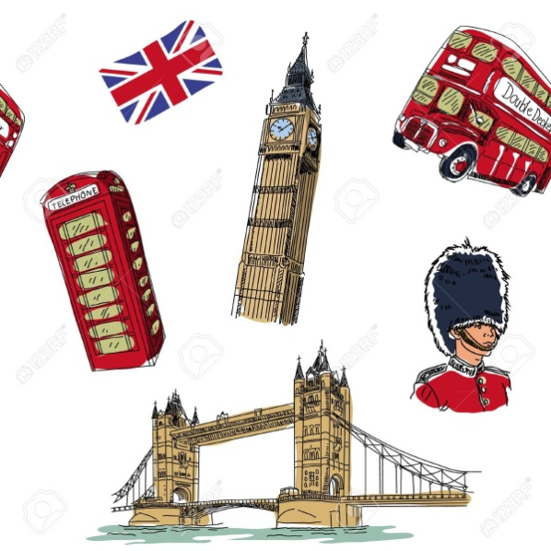
I would like to go to Britain …… - in winter. - in spring. - in summer. - in autumn.
First I would Like to see………
As a souvenir from London I want to buy
- a toy double-decker.
a book about London.
- a small British flag.

Slide 11
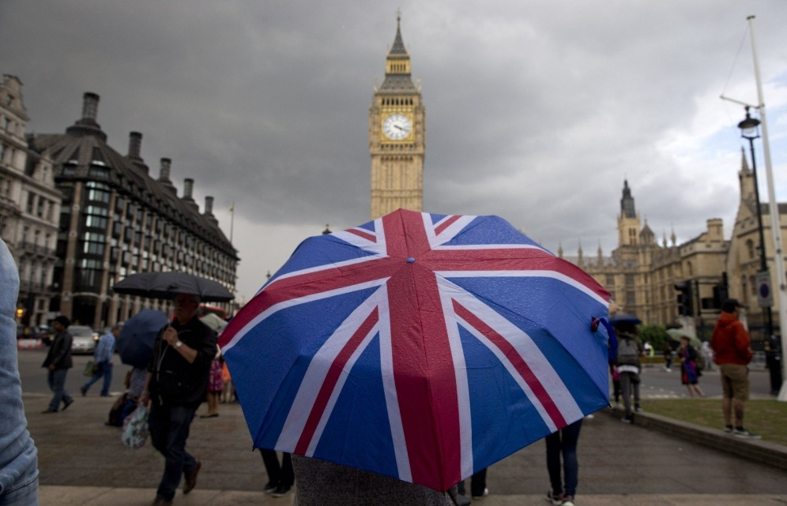
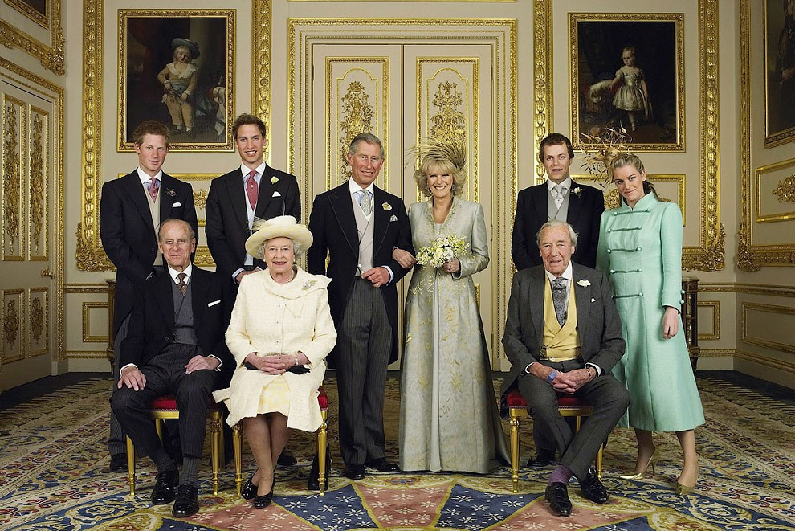
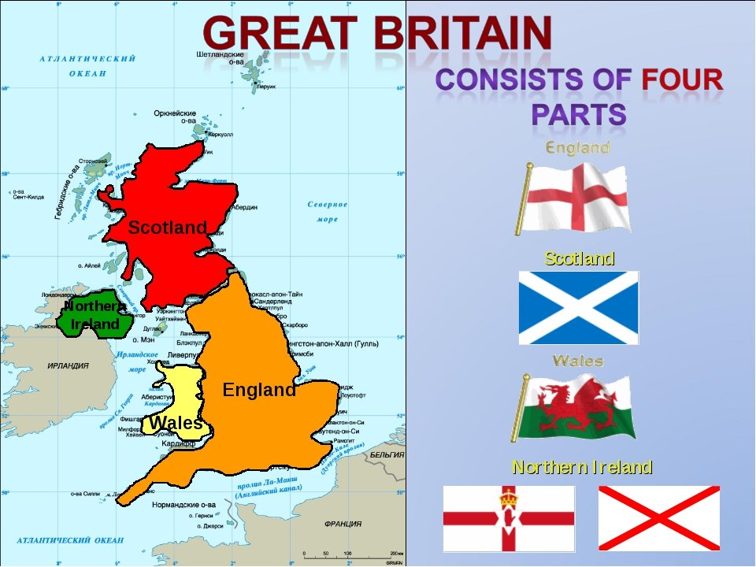
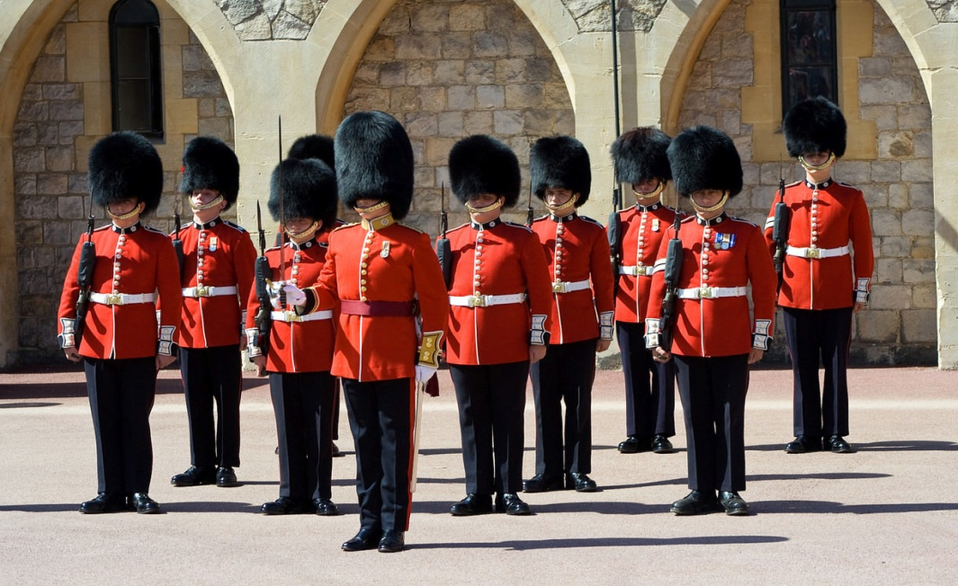
The United Kingdom

Slide 12
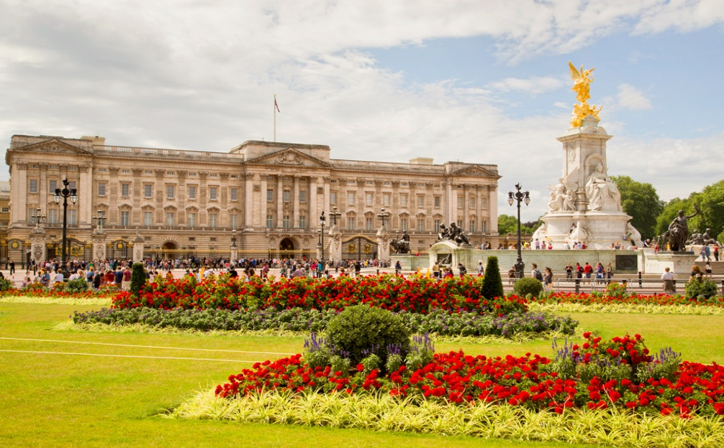
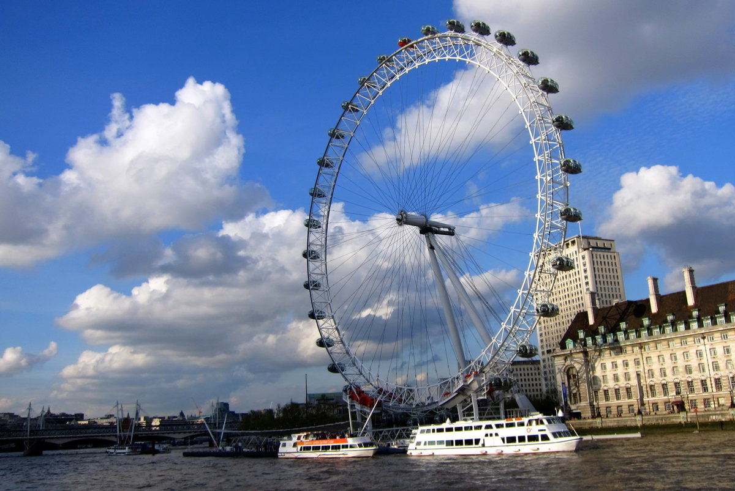
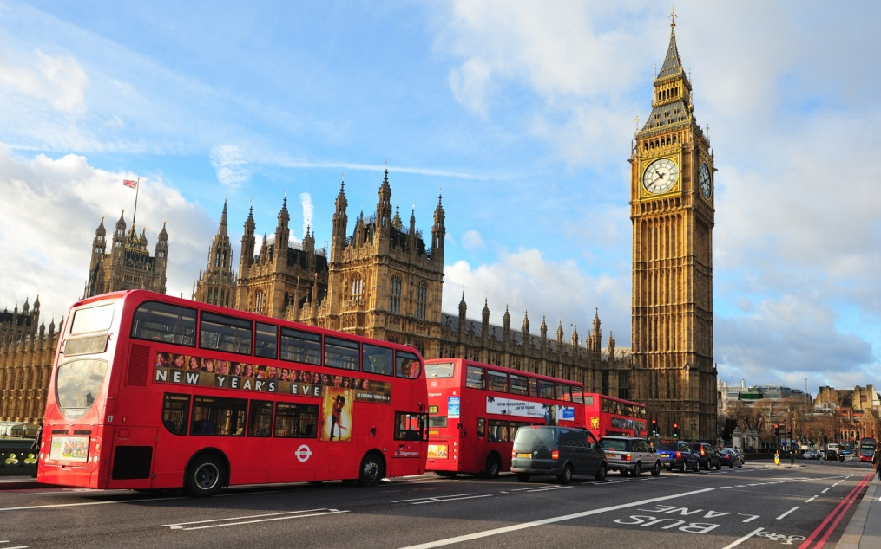
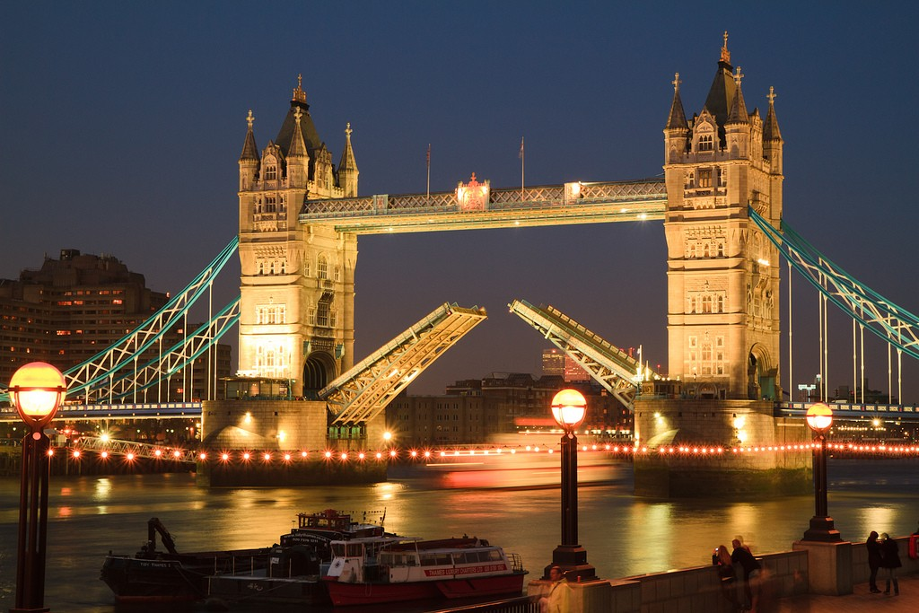
LONDON

Slide 13
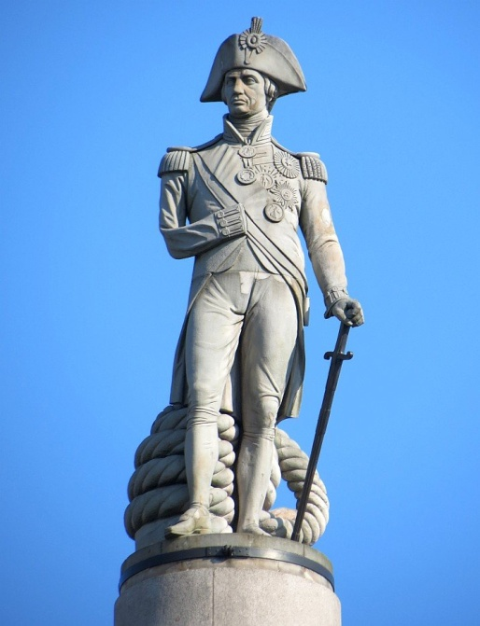
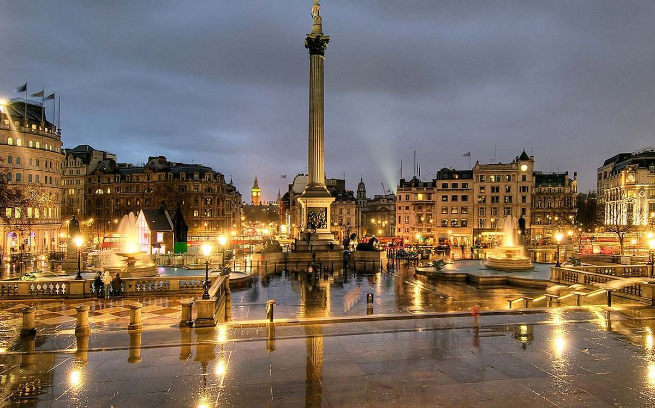
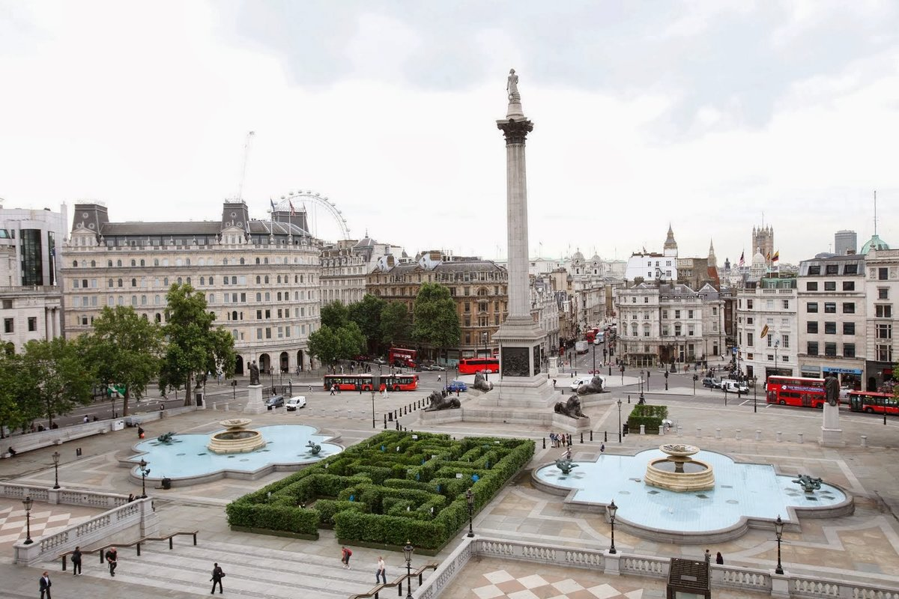
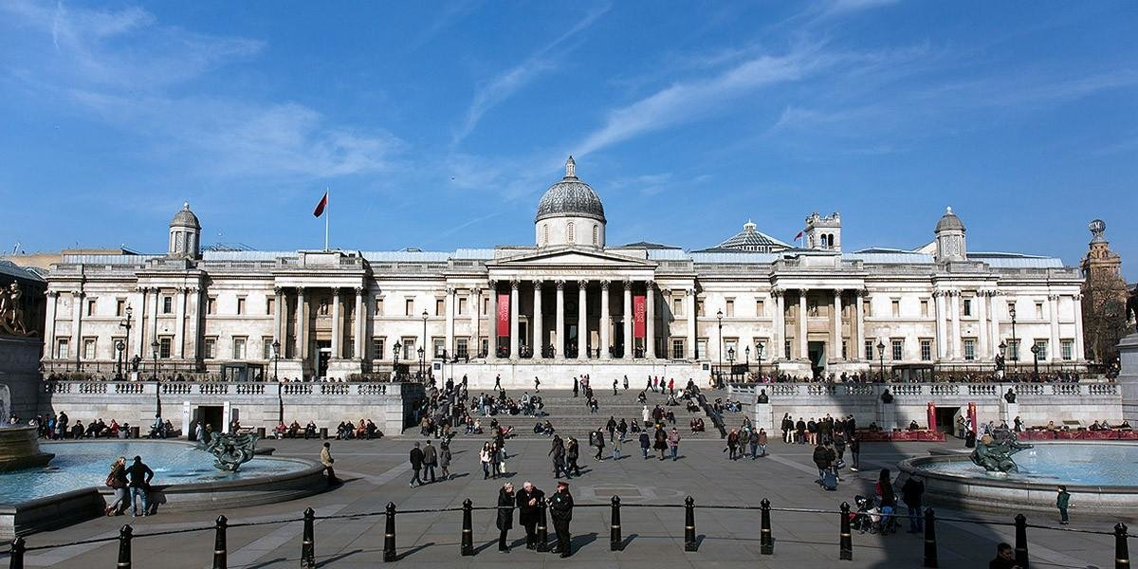
Trafalgar square

Slide 14
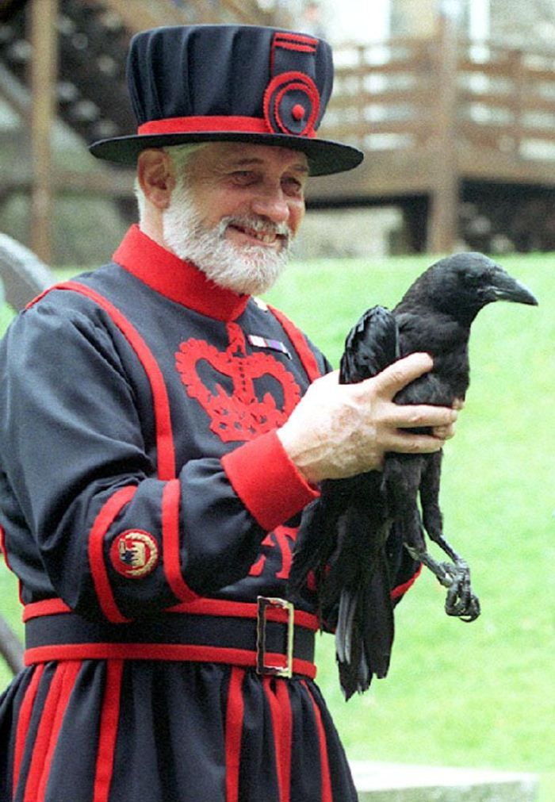
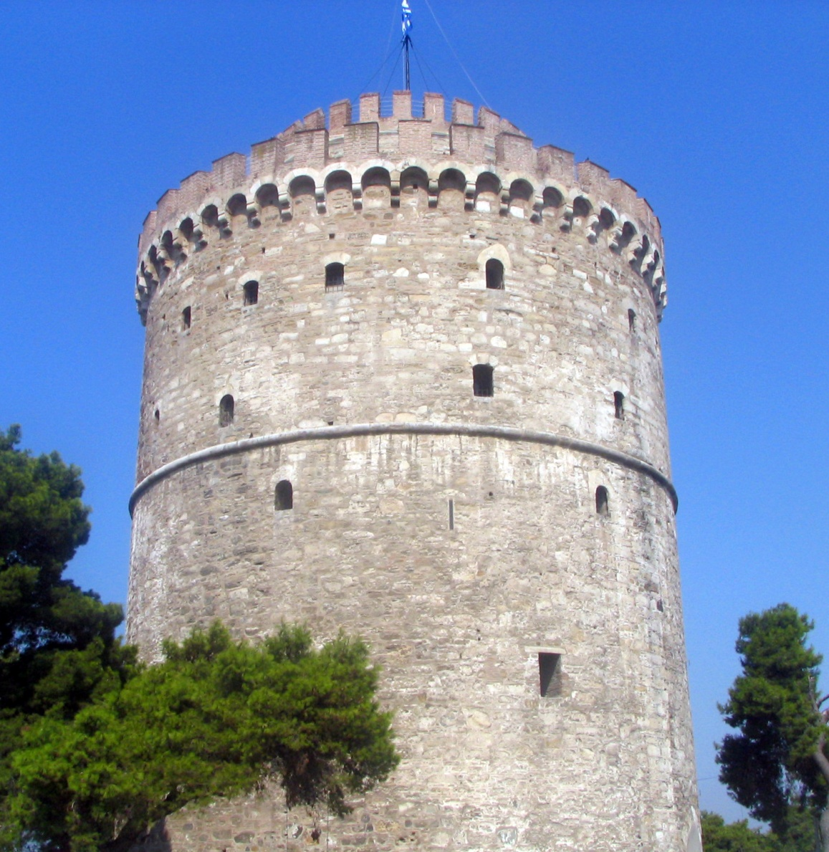
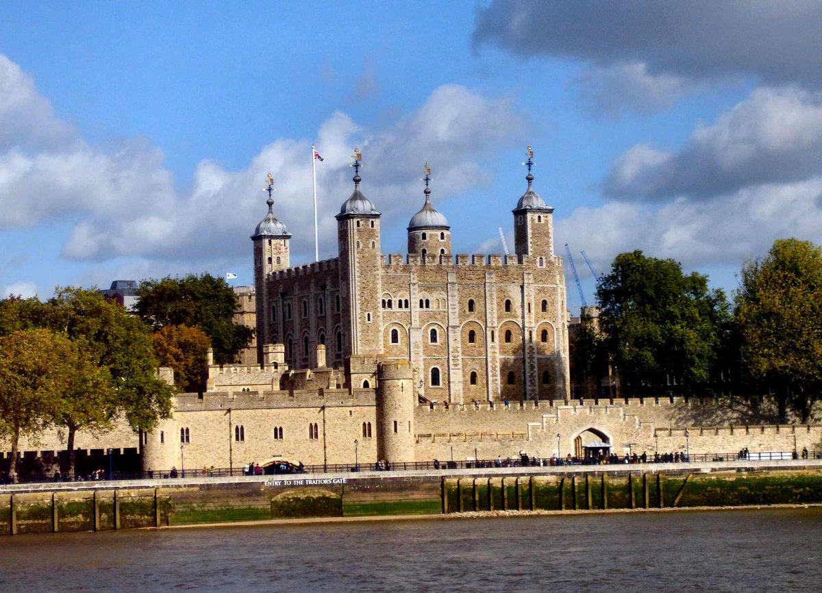
The tower of london

Slide 15
Синквейн Great Britain interesting , beautiful locate, have, visit I would like to visit kingdom

Slide 16
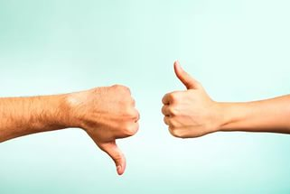

Slide 17
