Slide 1
READ The WOrds
Ride, cat, not, nose, head, nine, hand, parrot, ant, fine, sister, tiger, horse, four, house, plate, gate, sun, dark, black, fish, shine, fox, six, kite, daddy, elephant, snake, lamp, robot

Slide 2
Презентация к уроку английского языка
3 класс
Тема: «Глагол have got”
                Учитель Серова Л.В.
                МБОУ ЦО №2

Slide 3
ФОРМЫ ГЛАГОЛА HAVE GOT
I have got
You have got
He has got
She has got
It has got
We have got
You have got
They have got

Slide 4
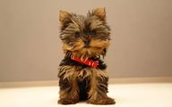
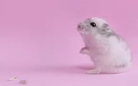
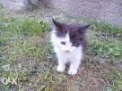
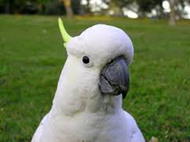
Вставьте have got или has got
He
has got
a
We
have got
a
I
have got
a
She
has got
a

Slide 5
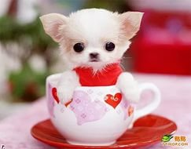
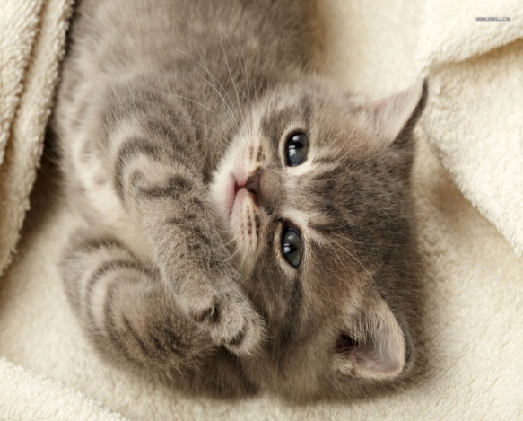
Отрицательная форма
I have not got
You have not got
He has not got
She has not got
It has not got
We have not got
You have not got
They have not got

Slide 6
Вопросительная форма
Have I got ?
Have you got?
Has he got?
Has she got?
Has it got?
Have we got?
Have you got?
Have they got?

Slide 7
Составьте предложения
1. has, a, He, got, dog.
He has got a dog.
2. pen., not, We, got, a, have
We have not got a pen.
3. have, kitten., they, got, grey, a
They have got a grey kitten.
4. she, got, dark, Has, hair?
Has she got dark hair?
5. not, blue, It, eyes., got, has
It has not got blue eyes.
6. cat? you, got, a, Have
Have you got a cat?
7.I, not, brother., have, a, got
I have not got a brother.

