Slide 1
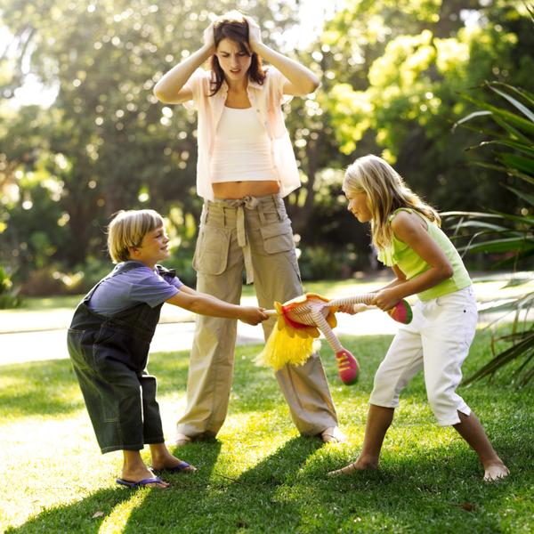
Conflicts in our life
Учитель английского языка Лебедева М.В
МБОУ СОШ №18 г.Энгельс.

Slide 3
Questions for discussing
What is conflict?
Whom do you often have conflicts with?
What types of conflicts do you know?
Where do conflicts lead to?
Why do conflicts happen?
How do you resolve conflicts?

Slide 4
[w] - war, world, wide, wisdom
[v] - violent, violence, violently
[r] - relate, relation, relationship, resolution,
respect, respectful, respectfully, reunion
[s] - solve, solution, support
[l] - lead, leader, leadership
[i:]- agree, agreement, disagreement, peace
lead, leader

Slide 5
to disagree
to argue
to shout
to hear
to lead to
to relate
to solve
to unite
to prevent
to avoid
to ignore
to criticize
to support
to differ from

Slide 6
Match the words with their definitions
Provide (v) | a) To have comfortable or friendly relations
2. Support (v) | b) To calm down or to rest
3. Discovery(n) | c) The opposite( opinion idea, advice,etc.)
4.Confident(adj) | d)Finding or learning something
5.Criticise (v) | e)A feeling that one can rely on oneself
6. Get on(v) | f)To indicate the faults of something
7. Contrary (adj) | g)To help by approval, sympethy,or by giving money
8.Relax(v) | h) To offer(food,drink,information, opportunity, etc.)

Slide 7
Match the words with their definitions
Ex.79
Provide | To have friendly relations
Support | To rest or to calm down
Discovery | The opposite(opinion, idea)
Confident | Finding or learning something
Criticise | A feeling that one can rely on oneself
Get on | To indicate the faults of something
Contrary | To help by approval, by giving money
relax | To offer(food, drink, help)

Slide 8
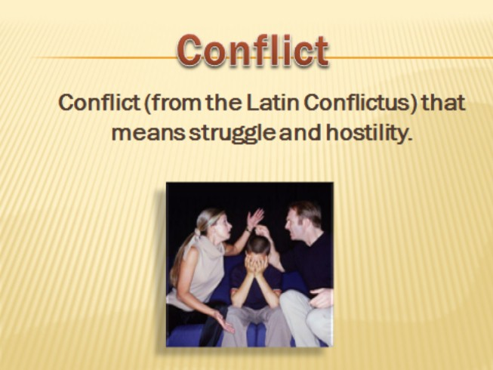

Slide 9
Conflicts is disagreement between two or more people:
when people argue
when people shout
when people quarrel
when people fight

Slide 10
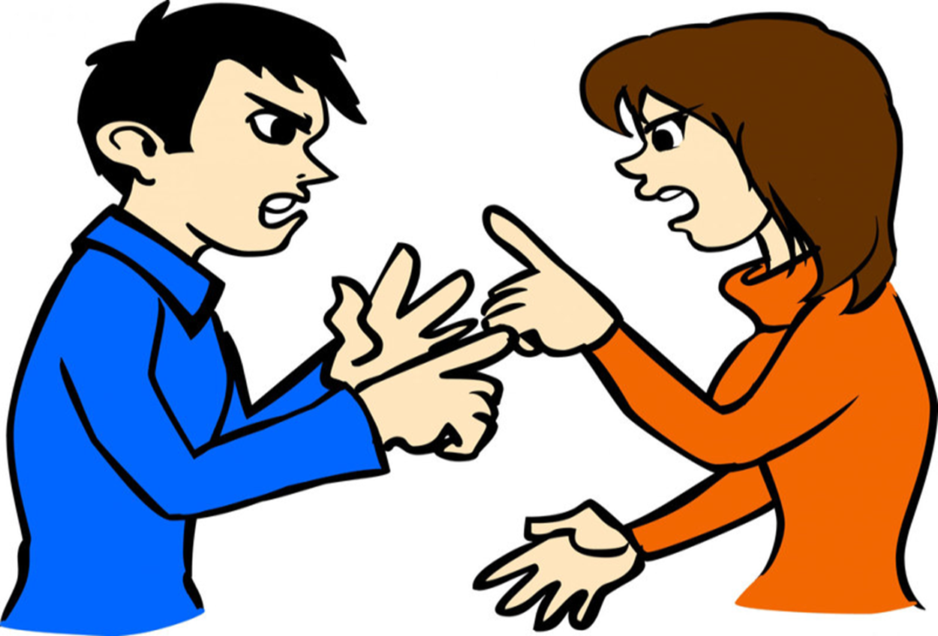
Conflicts are different :

Slide 11
War CONFLICTS
CONFLICTS AT SCHOOL
POLITICAL CONFLICTS
CONFLICT
NATIONAL
CONFLICTS
CONFLICTS in a FAMILY
CONFLICT AT WORK

Slide 12

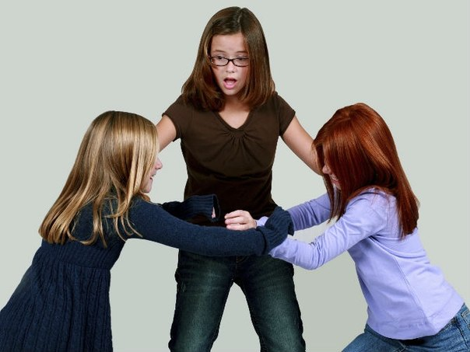

Slide 13

Conflicts between children and parents

Slide 14
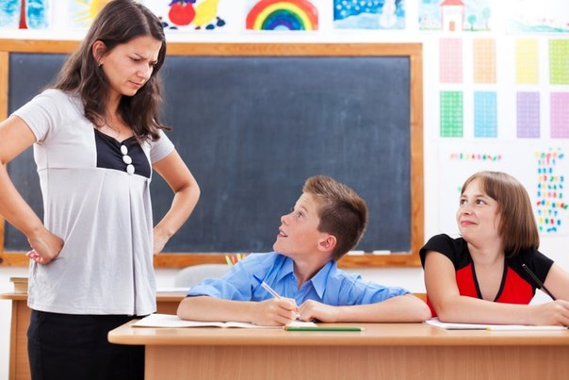
CONFLICTS BETWEEN A TEACHER AND A STUDENT

Slide 15
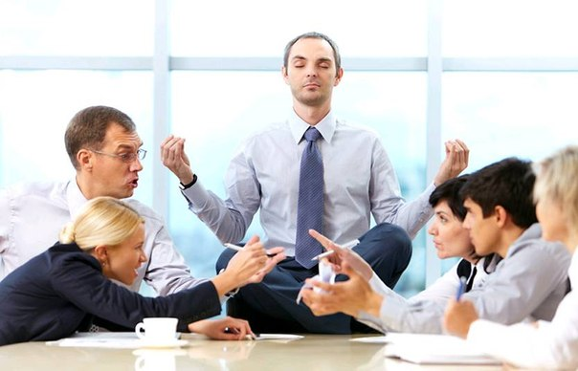
Conflicts at work.

Slide 16
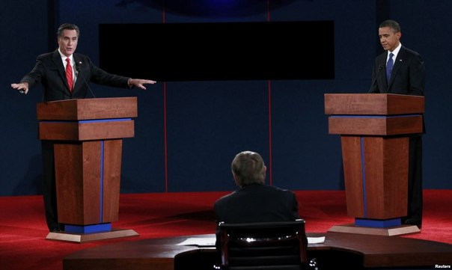
CONFLICTS BETWEEN POLITICAL PARTIES

Slide 17
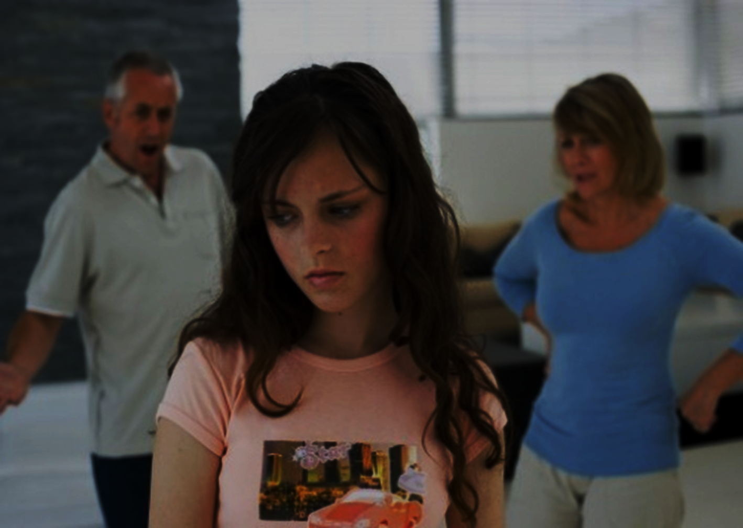

Slide 18
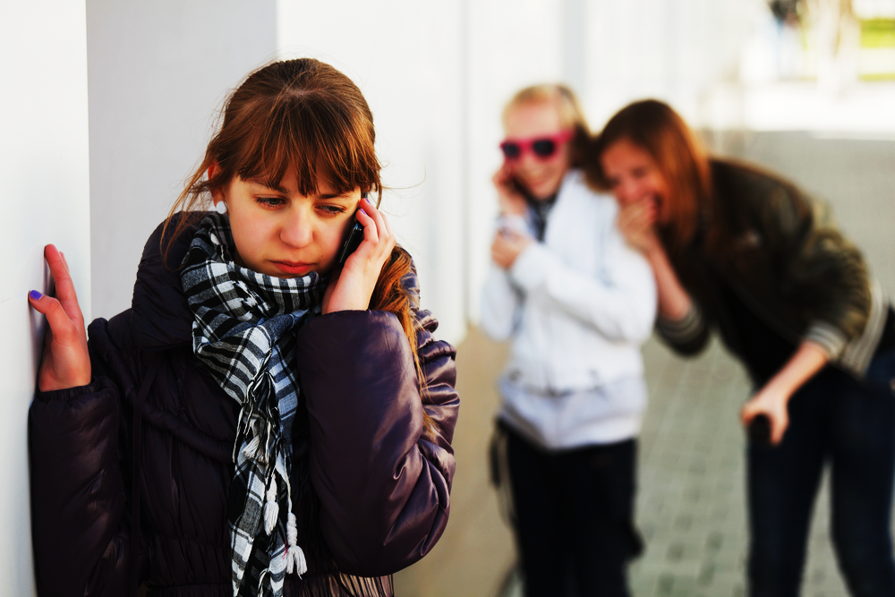

Slide 19
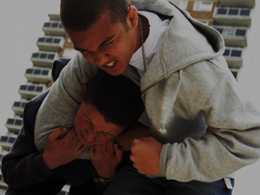

Slide 20
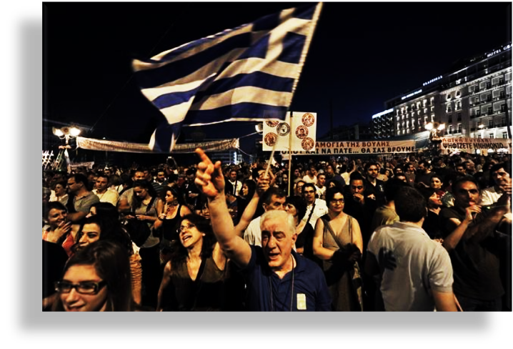

Slide 21
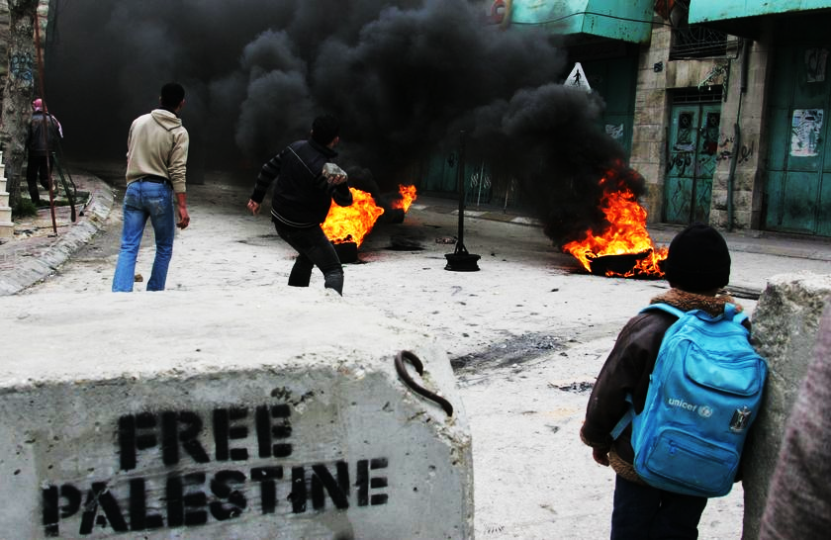

Slide 22
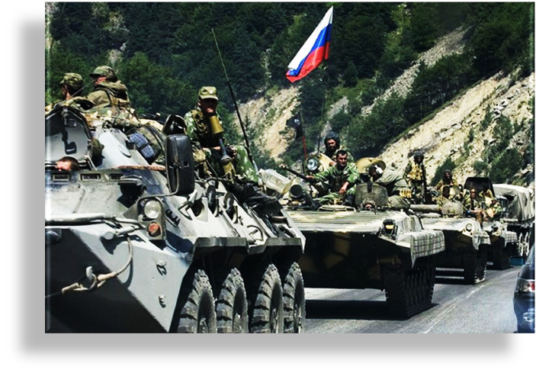

Slide 23
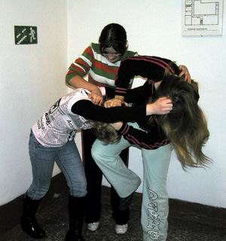
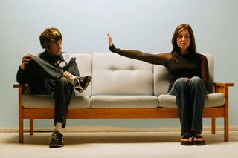
Where do conflicts lead to?
Conflicts may lead
us to …
Can we resolve
them peacefully?

Slide 24
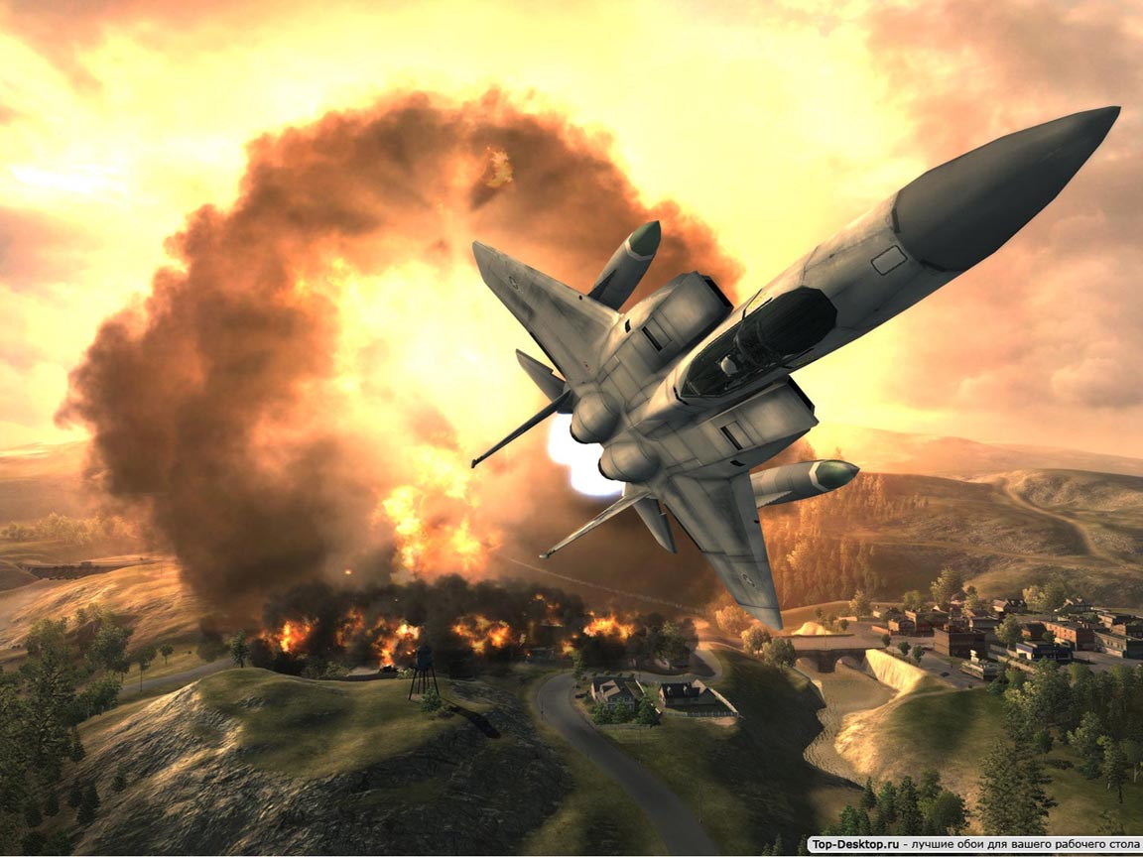
Conflicts can lead to war.

Slide 25
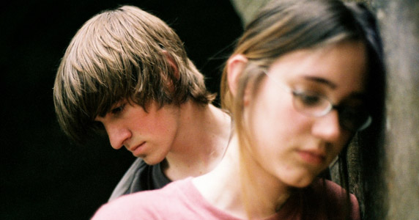
?
misunderstanding

Slide 26
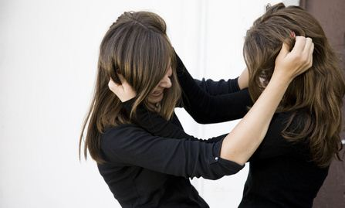
Conflicts may lead to fights, bad relations and violence.

Slide 27
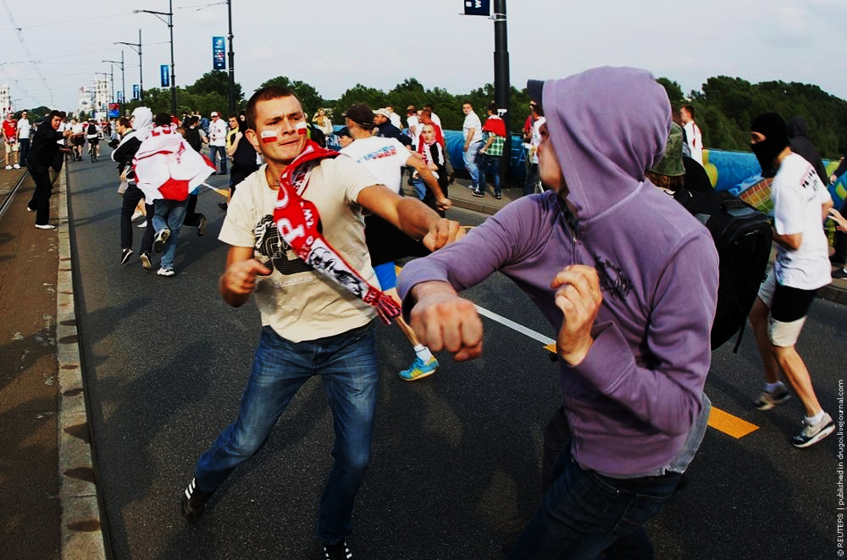

Slide 28
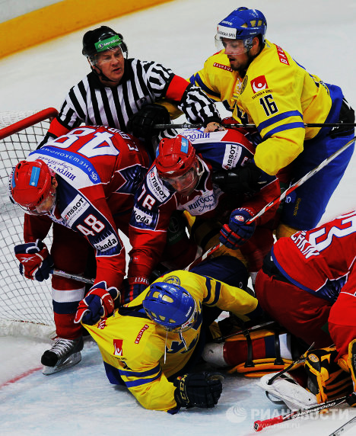

Slide 29
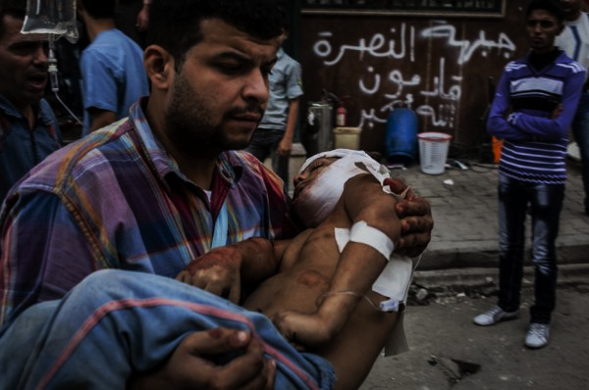

Slide 30
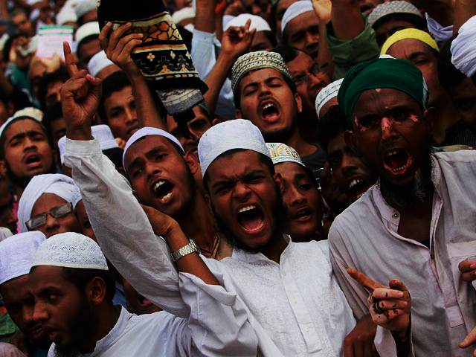

Slide 31
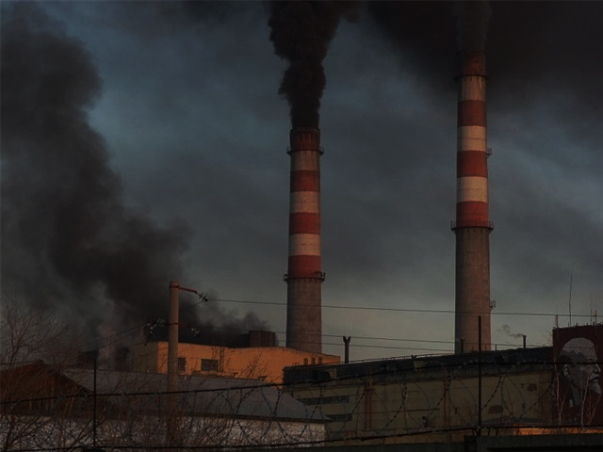

Slide 32
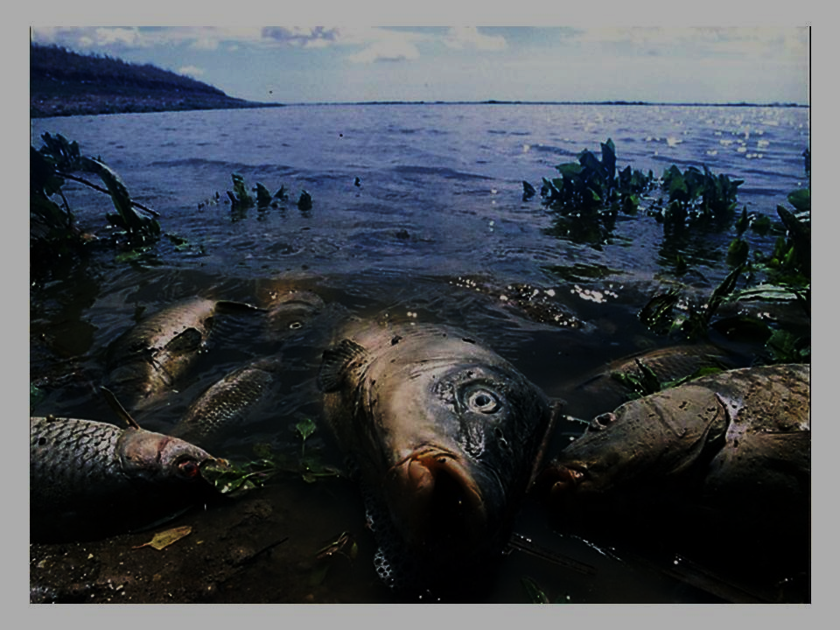

Slide 33
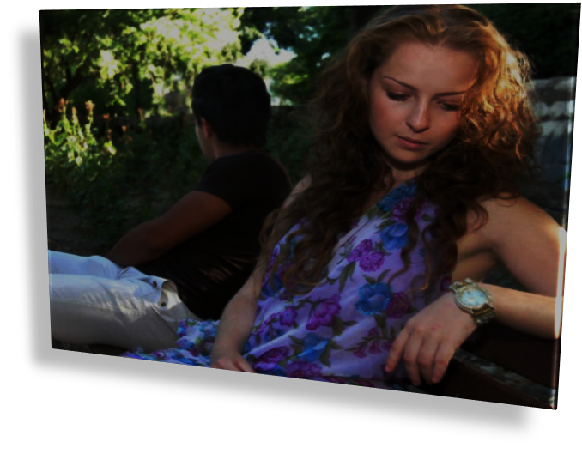

Slide 34
Finish the sentences.
If people do not listen well, it leads to…
If people do not respect each other, it leads to…
If conflict happened between states or political parties, it leads to…

Slide 35
Where do conflicts lead to?
Conflicts may lead
us to …
Wars and fights
Misunderstanding
Bad relations
Can we resolve
them peacefully?

Slide 36
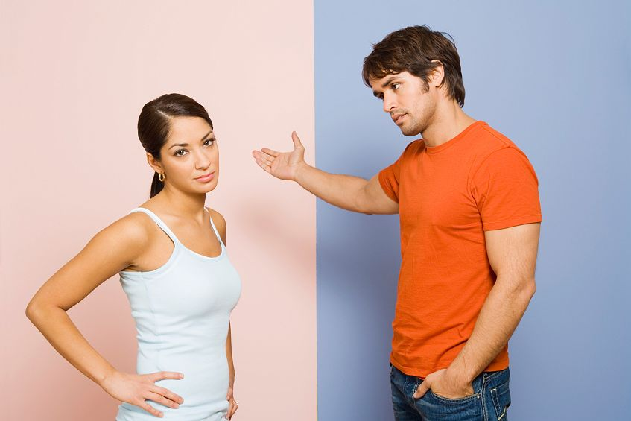
Why do conflicts happen?

Slide 37

Different people – different values
Разные люди, разные ценности

Slide 38
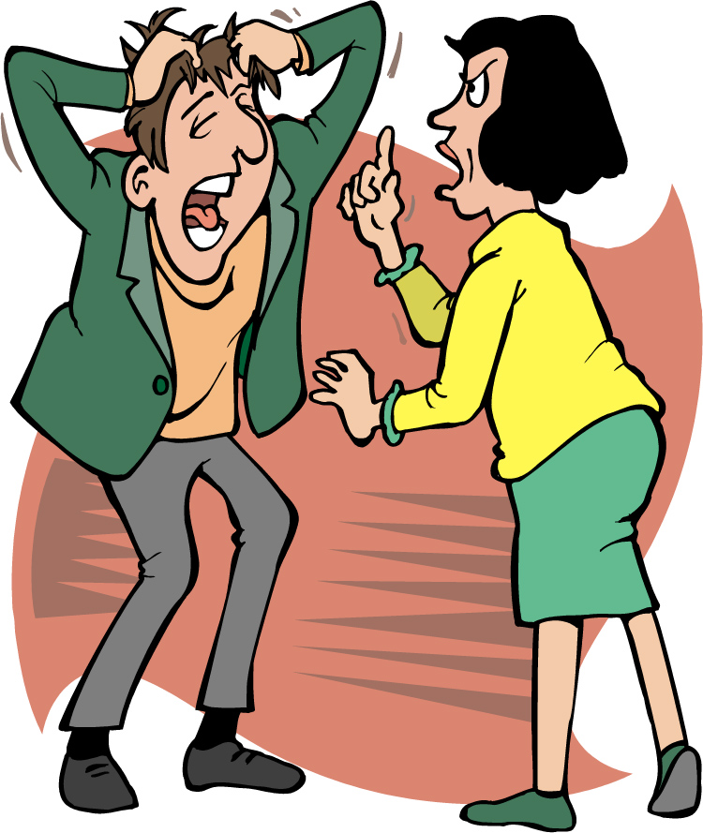
They don’t listen to each other

Slide 39
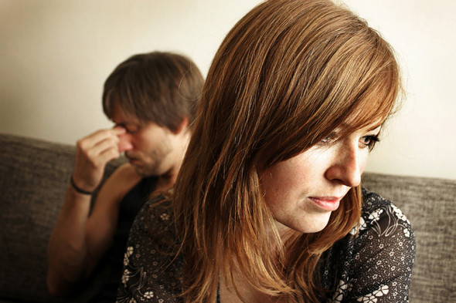
People are different: they have different ideas…

Slide 40
How to resolve a Conflict
ALWAYS | NEVER
ask for advice smb. who is older than you
punish unfairly
be optimistic
be confident and relaxed
bother someone
quarrel with people
speak calmly
trouble people
cheer up people
listen attentively to other people
think about conflict
ignore someone’s opinion
bully people
Make fun of people
avoid looking for a peaceful solution
keep a sense of humor
provide a solutoin
talk to people

Slide 41
How to resolve a conflict?
Be tolerant
You should understand that other people also have the right to be different from you.
Put yourself in the shoes of another person
You should solve all problems peacefully

Slide 42

Bad peace is better than a good quarrel!

Slide 43
Be tolerant!
And you’ll prevent
All conflicts in the world!
We should learn to live in peace
With classmates, parents, friends

Slide 44

Your homework!
Write about your conflicts and how you resolve them.

